Slide 1
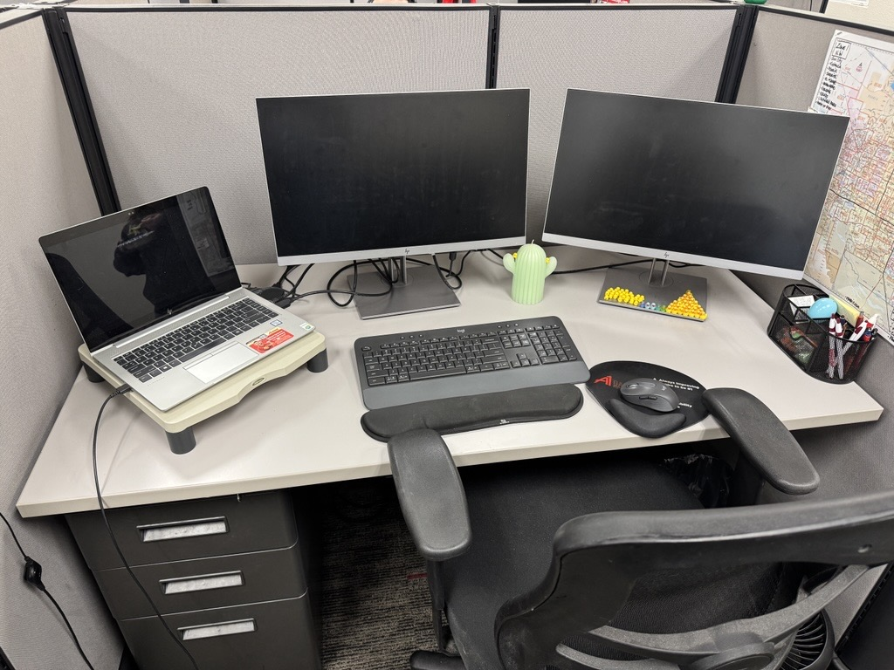
Standard Dispatcher Workstation
Suggested Desk Setup
Suggested Programs for Efficiency and Ease of Use
ServiceTitan
DialPad (or any other phone service)
Outlook
Fleet GPS tracking system
Dispatch Portal (something like SharePoint)
Microsoft TEAMS (or any other communication app)

