Slide 1
Safety Basics
What you NEED to have and what you need to know…

Slide 2
Agenda:
Safety Program – Most basic required documentation.
Minimum Site Safety Requirements.
How to find Federal and State OSHA requirements.
Staying ahead of Worker’s Compensation.

Slide 3
Safety Program Basics
Basic Required Documentation

Slide 4
Safety Program Basics:
Injury & Illness Prevention Program - Outlines management safety responsibilities/employee responsibilities.
This explains your formal training and re-education process.
Heat Illness Prevention Plan – Check your state requirements. A minimum requirement is that the employer purchases water or makes water, rest, and shade readily available for employees.
Bloodborne Pathogen Training and Safety Plan.

Slide 5
Safety Program Basics (Continued):
Most basic documentation:
Accident Reporting and investigation Process/Procedures.
OSHA Required Recordkeeping and Reporting.
Worksite Analysis and Hazard Identification.
Hazard Prevention and Control/Hazard Correction Procedures.
Hierarchy of Controls - PPE Safety and Training.

Slide 6
Safety Program Basics
Basic Site-Safety Requirements

Slide 7
Basic Operations Safety Listed Requirements:
(May vary by state):
If the work setting is an office, mechanic shop, welding shop, warehouse, or even a manufacturing plant – It all falls under General Industry.
Construction, alteration, and/or repair, including painting and decorating falls under Construction standards
Walking Working Surfaces – floor safety, platform safety, stairs.

Slide 8
Basic Operations Safety Listed Requirements:
(May vary by state):
Egress - exit routes, electrical breaker boxes, and emergency equipment cannot be blocked.
Housekeeping – maintaining a clean work area.
Appropriate and CORRECT PPE based on PPE assessment and hazard identification.

Slide 9
Basic Operations Safety Listed Requirements (Continued):
Machine guarding and LOTO.
Electrical Safety.
Proper Storage of Chemicals, SDS, and updates.
Fall Protection (where applicable).
Tool and Equipment Safety and training.
Emergency Procedures and contact numbers.

Slide 10
OSHA Requirements
What is required by federal or state standards?
How to find requirements for your business?

Slide 11
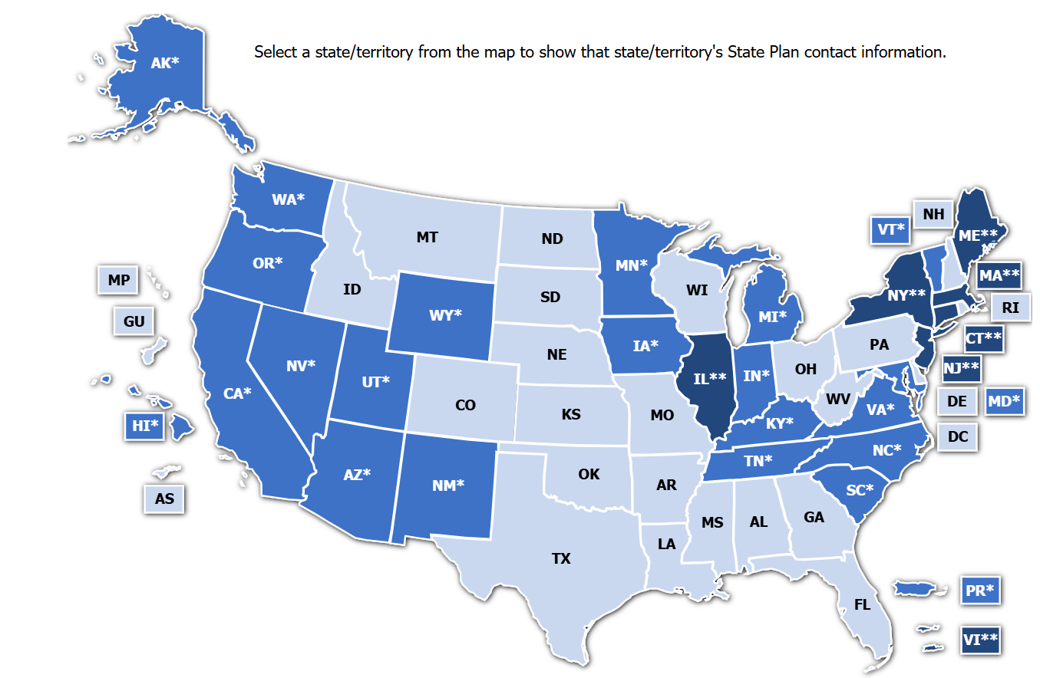
How to find OSHA or State requirements:
Go online to: https://www.osha.gov/stateplans
Click on your state.
A pop-up will show and explain who is covered (federal and local government workers, Private sector employees.

Slide 12
There are other safety/environmental entities as well:
Department of Environmental Quality may have a different name depending on your state.
Counties or cities may have permits required for air, stormwater, industrial water, hazardous waste removal, fire, and rack permits.

Slide 13
Required Postings:
States will have posters that are required by law.
Insurance brokers and carriers will be happy to help with required postings and resources – some are free!

Slide 14
Injuries and Work Comp – Staying Ahead
300 Log annual reporting requirements
Industrial Labor/Relations offices – their role and yours
Work Comp Insurers
Incident Reporting & Procedures

Slide 15
Staying Ahead of Worker’s Compensation:
Update your 300A log regularly (if you have over 10 employees).
If the company uses services such as TriageNow, TelaDoc, or Nurse-First, ensure you have a copy of their incident report, updated employee work status, and future appointment follow-ups.
Ensure a root cause analysis is completed for every incident. Ask open-ended questions instead of “Yes” or “No” questions.
It’s like pulling weeds. You can eliminate the ugly incident by targeting the roots, not the plant.

Slide 16
Staying Ahead of Worker’s Compensation (Continued):
Develop and build a relationship with your work comp insurer.
Safety audits help, request one. It helps bring the real picture of your business needs instead of what you THINK you need.
Most offer FREE employee training topics.
Ergonomic assessments are a plus. Sprains and Strains can take longer than broken bones and become more costly.
Develop and build a relationship with your occupational health clinic/provider
Create and implement claims handling procedures
Let clinic know of Return-to-Work program, provide job descriptions
Educate employees and supervisors on procedures and recordability (i.e. first aid)

Slide 17
Staying Ahead of Worker’s Compensation (Continued):
Get help with establishing (or at least feedback) on your injury reporting procedures. Time is of the essence when an injury occurs, but TIMELY DOCUMENTATION will protect you and your employees.
Accurate documentation: photos, video, easy to follow and fill incident report.
Incident reporting should be efficient to help with claims management.
Create a return-to-work Task Bank. What can the injured employee do when “modified duty” is requested by the medical provider?

Slide 18
Enforcement Tips:
Strong Leadership
Communication
Active Hazard Identification
Policies and Procedures
Employee involvement
Accountability
Effective Incident Reporting
Continuous Improvement

Slide 19
Enforcement Tips to Follow:
Strong Leadership Commitment:
Lead by Example: High-level management should actively participate in safety initiatives, setting a positive tone. Communicate Clear Expectations: Clearly articulate safety expectations to all employees, from top to bottom.

Slide 20
Enforcement Tips to Follow:
Comprehensive Safety Training: Required Training: Provide required, mandatory safety training to all employees.
Tailored Training: Ensure training is relevant to specific job roles and potential hazards.
Document Training: Keep accurate records of training sessions and employee participation.

Slide 21
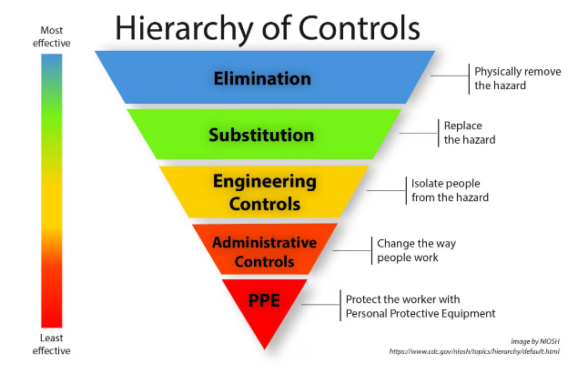
Enforcement Tips to Follow:
Effective Hazard Identification and Control:
Regular Inspections: Conduct routine safety inspections to identify potential hazards.
Hazard Assessments: Perform thorough risk assessments to prioritize hazards and develop control measures.
Implement Control Measures: Take immediate action to eliminate or minimize identified hazards.

Slide 22
Enforcement Tips to Follow:
Clear Safety Policies and Procedures:
Develop Written Policies: Create clear, concise, and easily understood safety policies and procedures.
Communicate Policies: Ensure all employees are aware of and understand the policies.
Enforce Consistency: Consistently enforce safety policies and procedures across the organization.

Slide 23
Enforcement Tips to Follow:
Employee Involvement and Empowerment:
Encourage Reporting: Establish a system for employees to report safety concerns without fear of retaliation.
Involve Employees: Seek input from employees on safety issues and improvement opportunities.

Slide 24
Enforcement Tips to Follow:
Consistent Enforcement and Accountability:
Progressive Discipline: Implement a progressive discipline system for safety violations.
Fair and Consistent Enforcement: Ensure that disciplinary actions are fair and consistent.
Accountability: Hold supervisors and managers accountable for failures in enforcing safety rules and regulations.

Slide 25
Enforcement Tips to Follow:
Incident Investigation and Reporting:
Thorough Investigations: Conduct thorough investigations of all safety incidents to identify root causes.
Corrective Actions: Implement corrective actions to prevent similar incidents from happening again.
Report and Document: Accurately report and document all incidents and corrective actions.

Slide 26
Enforcement Tips to Follow:
Continuous Improvement:
Performance Metrics: Track safety performance metrics to identify areas for improvement.

Slide 27
Lastly:
If the hazard requires rules, a process, and PPE, DO NOT negotiate with your employees. YOU set the standard because ultimately YOU will need to respond.

Slide 28
Carlos Perea
National Safety Manager
Office: (480) 630-1854
Email: cperea@a1garage.com

