Slide 1
Sales

Slide 2
Today’s Agenda
Mind set and control
Image and energy
Understanding your client
Body language and rapport
Talking about money
Client profiling and their specific concerns
Service is a full course meal
Presenting options
Guiding the client
Transparency and closing the contract

Slide 3
Mindset & Control
- What’s your mindset, and how can you affect it?
- What good comes from bringing personal problems into a call?
- Can you have more control at work or at home?
- Does success at home impact work, or does success at work influence home life more?

Slide 4
Image and Energy
Does your image or energy reflect your mindset?
Consider how a professional setting, like a lawyer’s office, compares.
KPIs
For example, wearing boots, a tucked-in shirt, dark jeans, and a forward-facing hat increased my sales by 25%. Whether it’s the “look good, feel good” placebo effect or something real doesn’t matter—I got the results.

Slide 5
Understanding Your Client
What do you really know about your client?
Sure, you can check Zillow for house information or browse their social media, but did you ask about things outside the problem you’re there to fix? Just as a human?
Service is about building a relationship. Don’t you want to get to know someone before getting into a relationship?

Slide 6
Body Language and Rapport
How do you become an expert on your client’s body language?
Talk about their passions, then get them to vent about something. This helps you understand how they communicate when they’re happy or upset

Slide 7
Talking About Money
How do you talk about money without directly discussing price?
My wife and I often discuss how everyone seems to be after our money. Can you relate this to your clients?
How does the way you or techs grew up with money affect the way they talk about money?

Slide 8
Client Profiling & THIER Concerns
Can you tell if your client is reacting to the problem at hand or to other life issues?
Did you ask about the history that led to you being called out?
What are your client’s concerns? They need to feel heard before they’ll hear you.
Appeal to their concerns before getting into your professional ones.

Slide 9
Service a Full Meal
Your service is like a full meal: drinks, appetizers, the main course, sides, and dessert.
Learn how to serve it in stages—this is how you build a ticket.

Slide 10
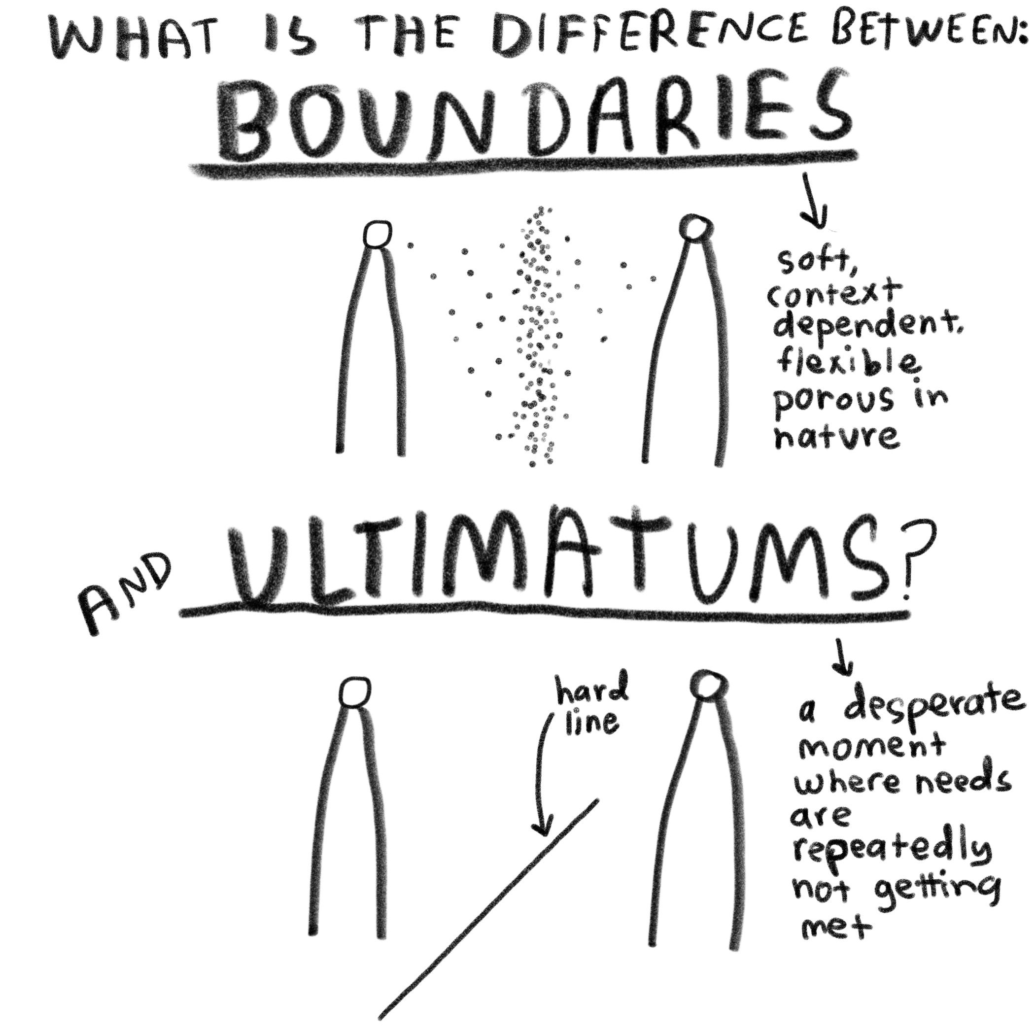
Presenting Options
When is it better to offer a new system?
Always present all options.

Slide 11
Guiding the Client
This is a journey you must guide the client through.
You’re the guide, but it’s on their time.

Slide 12
Transparency & Closing the Deal
Transparency can be the highest form of relationship with a client.
Getting paid is the second-to-last step.
Once paid, solidify the relationship, educate the client, and strengthen the connection.

Slide 13
Interesting studies
**Social Proof**
According to a study by Bright Local, 88% of consumers trust online reviews as much as personal recommendations.
Another study by Spiegel Research Center found that displaying reviews can increase conversion rates by 270%.
**Urgency and Scarcity**
A study by CXL found that adding urgency to a call-to-action increased conversions by 332%.
According to FOMO, nearly 60% of consumers said they would make a faster purchasing decision if they knew an item was in limited supply.
**Storytelling**
Research by Jennifer Aaker, a marketing professor at Stanford, found that stories are remembered up to 22 times more than facts alone.
Another study by One Spot found that storytelling can increase the value of a product by over 20 times.

Slide 14
Interesting Studies-Continued
**Benefits vs. Features**
According to a study by CEB, highlighting the benefits of a product instead of its features can increase sales by up to 20%.
**Building Rapport**
Research by Gong.io found that building rapport in the first five minutes of a sales call increases the likelihood of a successful sale by 56%.
**Follow-up**
The Association of Sales Executives found that 81% of sales happen after at least five follow-ups.
According to the Harvard Business Review, companies that nurture leads make 50% more sales at a cost 33% less than non-nurtured leads.

Slide 15
Thoughts & Questions…

