Slide 1
Presenting Your Best Business

Slide 2
Today’s Topics
9X7 Presentation
Genuine, Brave, & Confident
Offering Options
Getting the 2nd & 3rd knock
Q&A

Slide 3
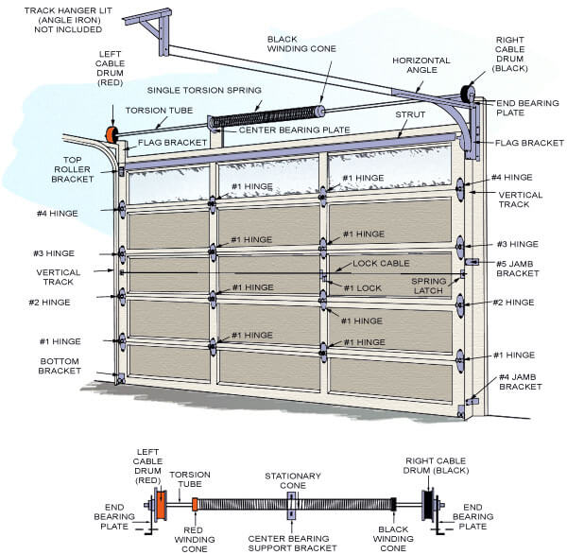
9X7 Training Door
Presentation skills
Confidence
Show & Tell
Practice
Demonstrations
Creating tonality
Generating excitement
Rapport building
Build Value
Technical Skills
Parts knowledge
Mechanical functionality
Education
Repetitive Motion
Builds Habits
Practice

Slide 5
Genuine, Brave, & Confident
Body Language
Eye Contact
Mannerisms
Be themselves

Slide 7
2nd….3rd…4th …knock
Became their guest
Asked questions
Educated the client
Explained the process/system
Created trust
Built value
Conducted a safety inspection
Speak with confidence

Slide 8
Offering Options
Stop selling out of your pocket
Know that repairing vs replacing are both options
Build the ticket
Solve the client before the repair
Fix what they called you out for first
Always ASK

Slide 9
Presenting your Best Business…
Teach techs to be master presenters
Go for NO
Build value and get the knocks
Presentation skills are equally important to tech skills
PRACTICE, PRACTICE, & more PRACTICE

