Slide 1
A Leadership Approach

Slide 2
Today’s Topics
Leadership Culture
Goal Setting
Addressing Toxic Behaviors
Meeting Magic
Champion Leadership
Q&A

Slide 3
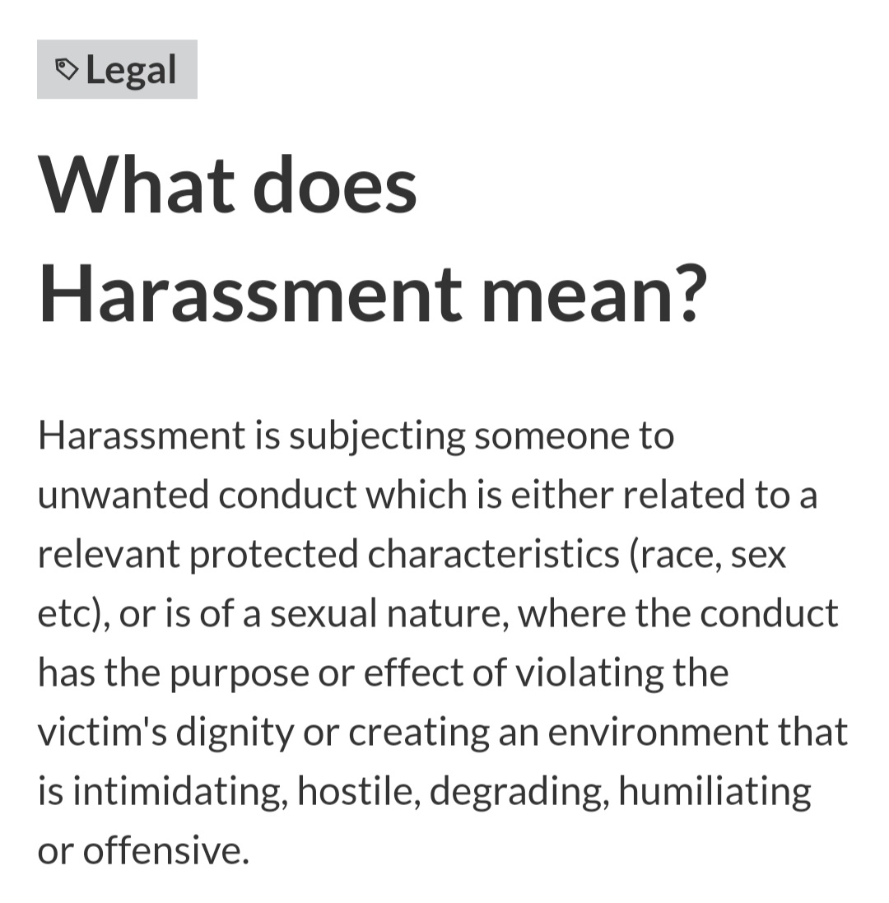
Leadership Culture
Healthy banter
Clean fun
Building & Making Memories
Team Sport; growth is the key; setting goals makes magic

Slide 4
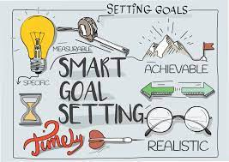
Goal Setting
Teach your team to set personal goals that correlate to their work goals
Talk about them often
Help them accomplish their goals
Goals should be visible
Celebrate the wins; talk about the opportunities
Create vision boards

Slide 6
Addressing Toxic Behaviors
Acknowledge the behavior
Coaching for awareness
Set good expectations & boundaries
Clarify the situation before addressing
Praise in public; coach in private
Pro-Tip: Sit with them in a neutral space to discuss areas of opportunity

Slide 7
Being a Champion
Leadership
Integrity
Consistency
Act independently throughout the training process
Coach in real time
Focus on building the strengths
Eliminating the objections or areas of opportunity
Confidently Uncomfortable
Doing the right thing for the company
Explain the “Why”
Ensuring safety is followed
Allowing the student to challenge them
Teaching to the process that meet the vision of the company
If the trainer does for one student, they must do for all
Repeat activities as needed till habits are formed
Be patient and creative in communication but keep the same processes
Don’t bend the standards

Slide 9
Communication

Slide 10
Active Listening

Slide 11
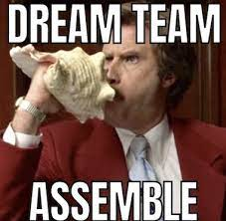
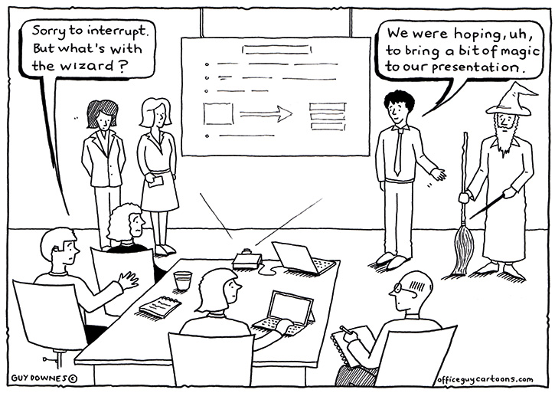
Meeting Magic
Entertaining
Command the Room
Humor/Fun makes it “sticky”
Visual aids
Specific
Have an agenda
Circle back on open questions from prior meetings
Leave time for questions

Slide 12
A Leadership Approach…
YOU create the tone
Set Goals
Address the negativity
Lead like a Champion
Make the most of your meetings

