Slide 1
BlueLion in Partnership with Garage Door Freedom

Slide 2
Business & HR 101
Presented by Toni Runci SHRM-CP, PHR
Senior Human Resource Consultant

Slide 3
Disclaimer
This presentation provides general information regarding its subject and explicitly may not be construed as providing any individualized advice concerning particular circumstances. Persons needing advice concerning particular circumstances must consult counsel concerning those circumstances.
These webinars are intended for educational purposes only. While we hope that you learn new information, the trainers presenting these webinars are not attorney. Therefore, all information provided during the presentation and the Q&A Session should not be construed as legal advice.

Slide 4
Who Are We?
BlueLion is a Human Resources Consulting Company.
Our purpose is to provide quality HR support to businesses, specializing in Blue Collar industries.
We are REAL people with personality!
We pledge 1% of our profit, services, and time to our community!
We only provide what YOU need and will NEVER sell you something you don’t.

Slide 5
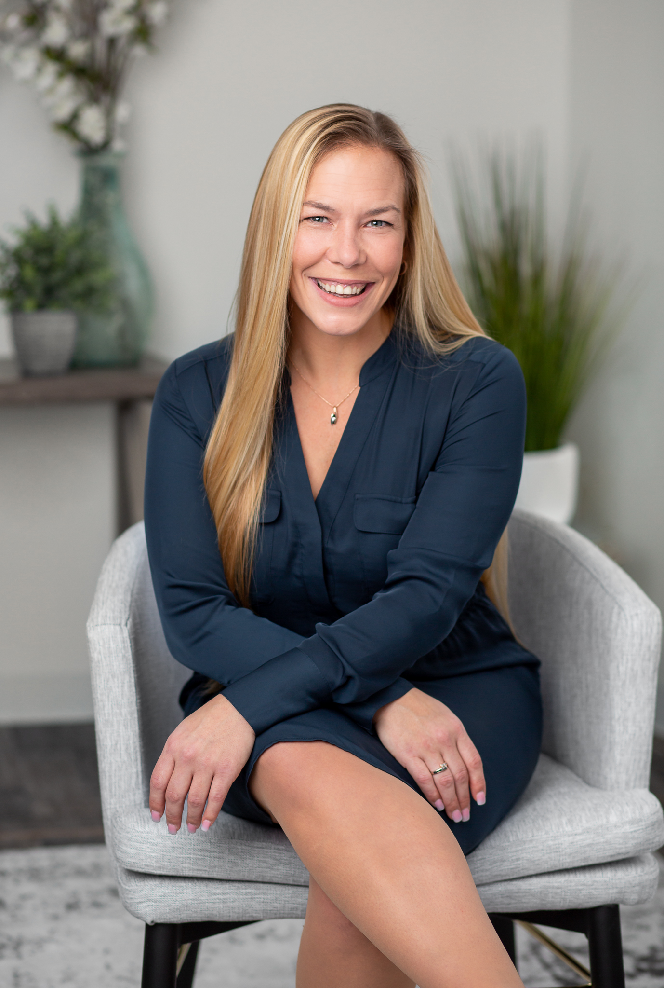
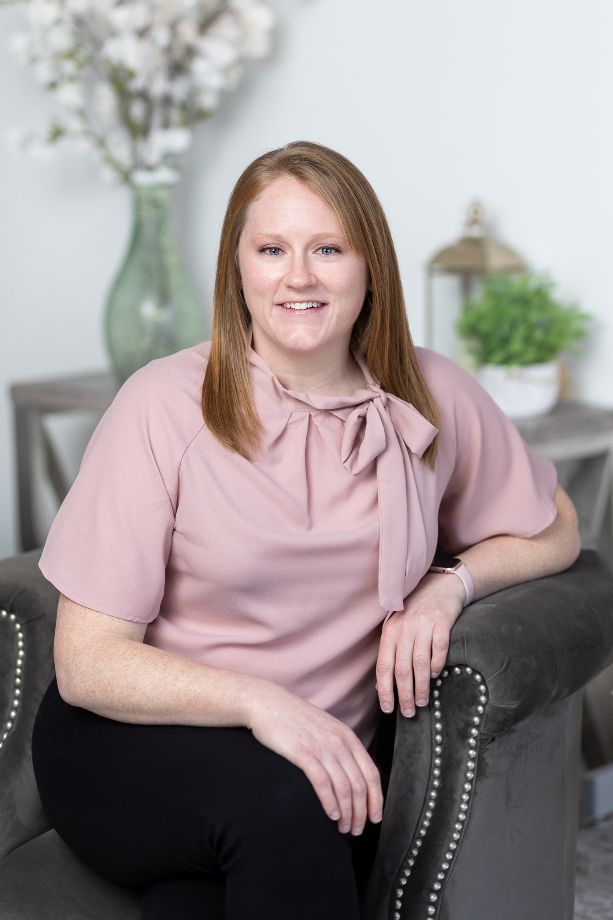
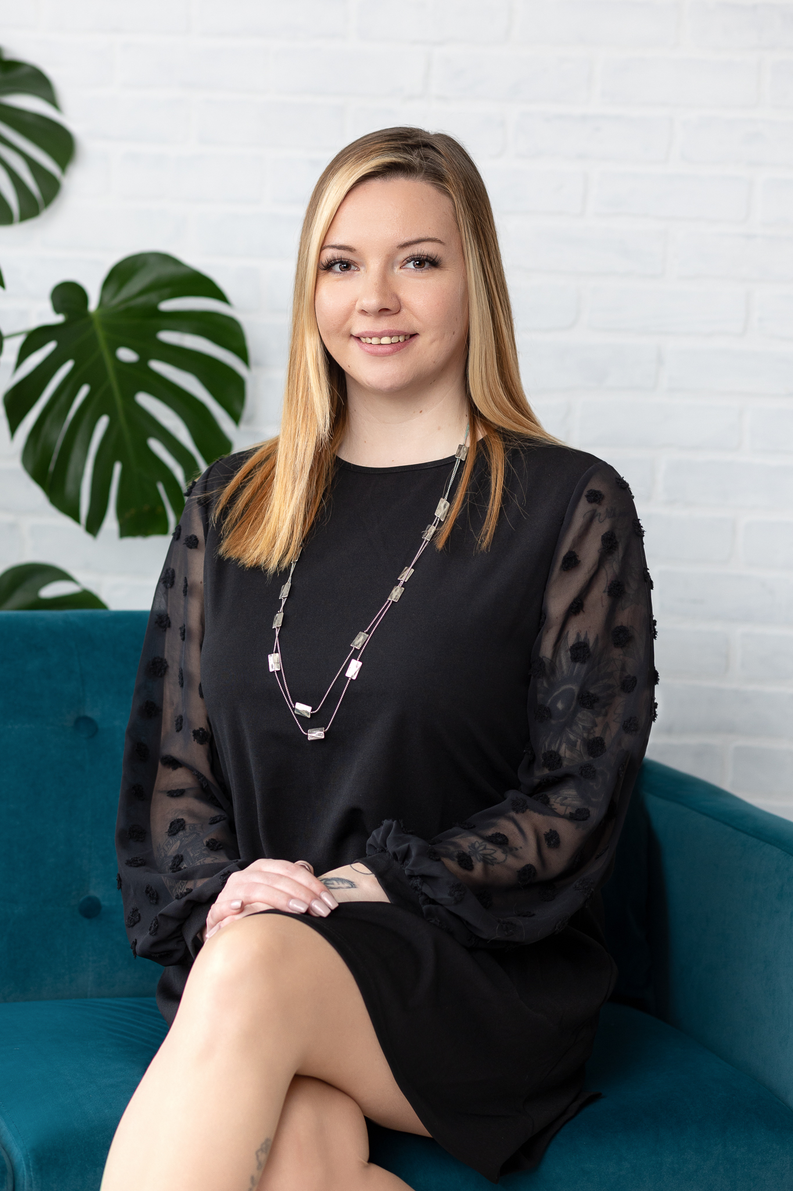
Our Team – HR Consultants & Admins
Alison
Amanda
Andie
Ashli
Christine
Jan
Mandy
Patrick
Stacy
Tom
Toni

Slide 6
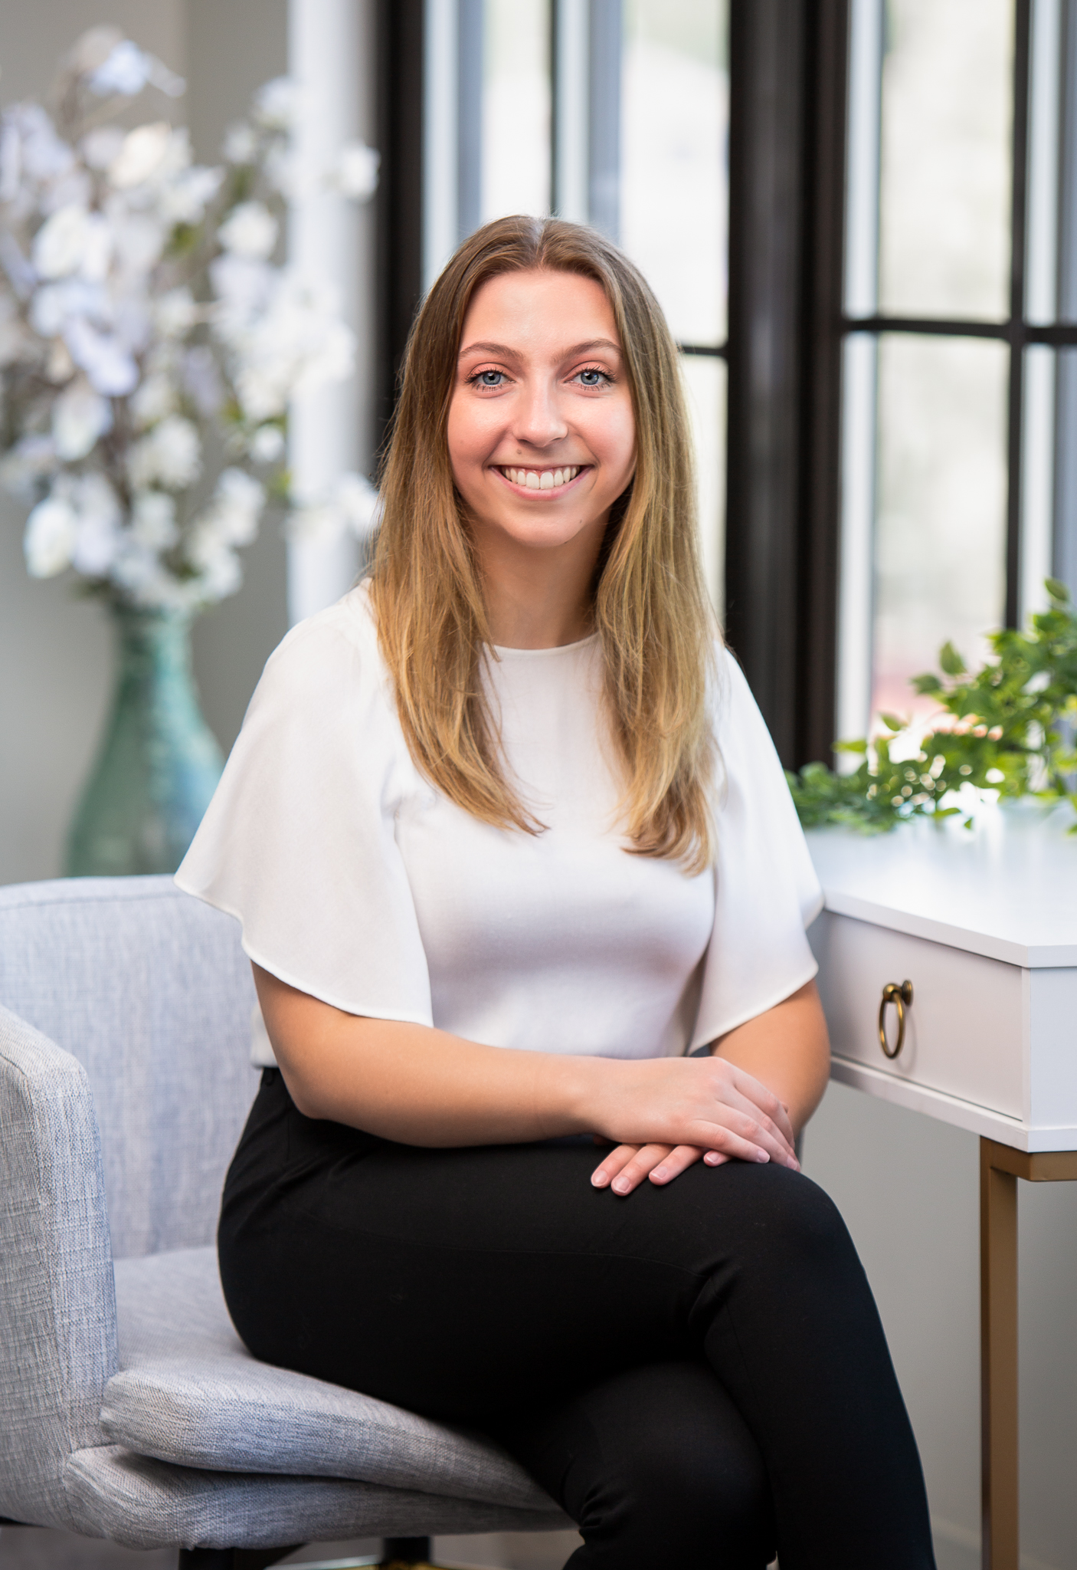
Our Team – Internal Operations
Chris
Operations Manager
Erin
Marketing Associate
Heather
Executive
Administrator
Michelle
Quality
Control
Nicki
Bookkeeper

Slide 7
Presenter | Toni Runci, SHRM-CP, PHR
Toni has over 15 years experience in HR. She received her undergraduate from SNHU in Business and her Masters in Human Resources.
She has worked in retail, construction, healthcare, automotive, and so much more.
She holds a certification from both SHRM (Society of Human Resource Management) and HRCI (Human Resource Certification Institute).
She is also a co-founder and owner of BlueLion.

Slide 8
Common HR Concerns
Payroll Compliance
Safety Plan – over 15 employees
Department of Labor Claims
Selecting and Implementing Benefits
Compensation Analysis
Incentive base pay structures
Recruiting and Retaining Staff
Handbooks and policies

Slide 9
Top DOL Violations

Slide 10
Violation #1 Failure to pay
All wages due for hours worked
Fringe benefits
Breaks less than 20 minutes, etc.
Payment of wages when resigning or terminated

Slide 11
Violation #2 Record Keeping
Failure to keep accurate record of all hours worked.

Slide 12
Violation #3 Illegal Employment Practices
Employing workers under 18 (not having proper paperwork, hours violations, or working in a hazardous environment).
Not adhering to meal breaks guidelines

Slide 13
Violation #4 Undocumented Workers
Employment of Undocumented Worker’s Prohibited.

Slide 14
Violation #5 Required Pay
Failure to pay minimum jour pay at their regular rate of pay on a given day that an employee reports to work at the request of the employer.

Slide 15
Violation #6 Workers Compensation Insurance
Failure to secure and maintain workers compensation coverage and misclassification of employees.

Slide 16
Violation #7 Wage Deduction
Illegal deductions from wages.

Slide 17
Violation #8 Notification of Rate Change
Failure to provide written notice to employees of their wage rate, pay period, payday and a description of fringe benefits, including any changes.

Slide 18
Violation #9 Minimum Hourly Rate
Failure to pay minimum wage for all hours worked.

Slide 19
Violation #10 Improper Classification of Independent Contractors
Every worker is considered an employee by law unless they can show themselves to be otherwise.
From a Department of Labor/Workers' Compensation standpoint, you are an employee unless you can qualify as an independent contractor.
In order to qualify as an independent contractor, you must meet ALL criteria

Slide 20
Benefits 101

Slide 21
What Are “Standard” Benefits?
Health
Vision
Dental
Paid Holidays
Paid Vacation

Slide 22
Supplemental Insurance
Life Insurance
Hospital Insurance
Accident Insurance

Slide 23
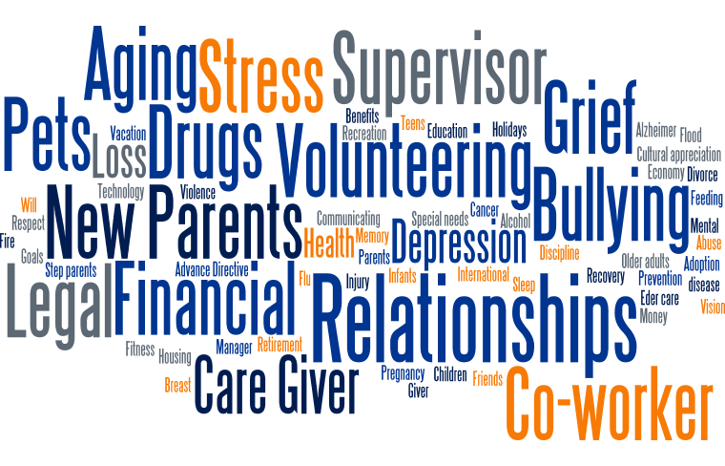
EAP (Employee Assistance Program)
The goal of an EAP is to provide employees with the tools and resources that they need to improve their mental health and help balance their work/life.
This will ultimately benefit the employer by creating a workforce with increased productivity, improved retention rates and “happier” or more satisfied employees.
Check with your Short-Term Disability Provider or Healthcare Provider
Modern Health
Spring Health
LifeWorks
Ulliance

Slide 24
Now Trending
Paid Parental Leave
Pledge 1%
Volunteer time off
THNKS - Appreciation
Tuition Reimbursement
No Meeting Days
Bereavement Leave (pregnancy loss leave)
Workplace Wellness
Flex Scheduling – telecommuting
Will Preparation
Home Cleaning
Office Snacks
Pet Insurance
Dry Cleaning Service
Food/Grocery Delivery Service
Mobile Auto Service
Mortgage Specialist
Local Business Discounts

Slide 25
Hiring & Retention

Slide 26
Tips & Tricks on Recruiting in 2024
Build a Strong Recruiting Program
Utilize an ATS (Applicant Tracking System)
Effective Job Postings
Beef Up Benefits
Showcase Your Culture
Open House?
Enhance Your Employer Brand Strategy

Slide 27
Tips & Tricks on Recruiting in 2024
Lean on Your Current Employees (referral bonus?)
Meet Elite Candidates Where They Are
Streamline Your Interview Process
Prioritize Candidate Communication
Don’t Take Too Long To Decide

Slide 29
Our Mission
Ensure the long-term success of our clients by using a realistic approach to Human Resources while maintaining a healthy work/life balance.
Our Core Purpose
Authenticity, out of the box, meet our clients and employees where they are at.

Slide 30
Our Services
Complete Outsourced HR Solution
HR Projects/Training
HR Hotline
Operations Clients
HR Gap Coverage
HR Audit
Harassment Training
Employee Handbook
Safety Manual
Performance Appraisals
Monthly On-Site HR Support

Slide 31
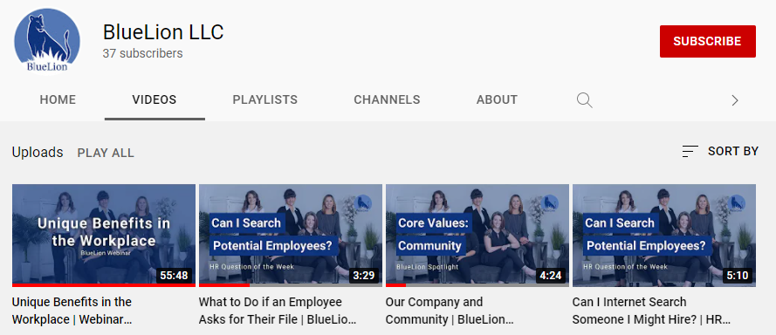
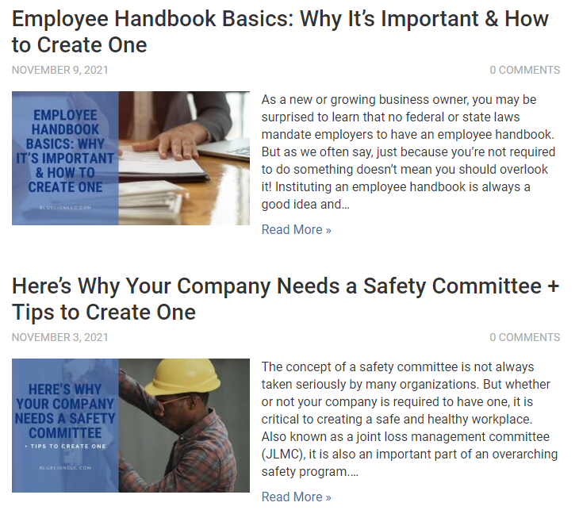
Additional Resources
Monthly HR Trainings/Webinars
YouTube Quick Videos
Over 30 Video’s of quick HR Hot topic questions and answers.
HR Blog
Over 50 Blog’s on HR Topics such as handbooks, leave of absence, COVID, payroll, benefits, safety, policies, and more…

Slide 32
2024 Training Topics & Meetings
Jan - DOL Audit – How do we handle, what do we do?
Feb - Implementing DEI Programs - What are they, and what does that look like?
Mar - Managing ADA (Americans with Disabilities Act) Accommodations
Apr - Payroll Compliance - Top 10 Payroll Errors
May - Managing Top Performers
Jun - Personality Testing & Hiring - Why? And does it work?
Jul - Performance Management - Creating a Performance Improvement Plan (PIP)
Aug - Concerted Activity - What is it and what can I do about it?
Sep - Wowing During New Hire Onboarding
https://bluelionllc.com/events/

Slide 33
Questions?

Slide 34
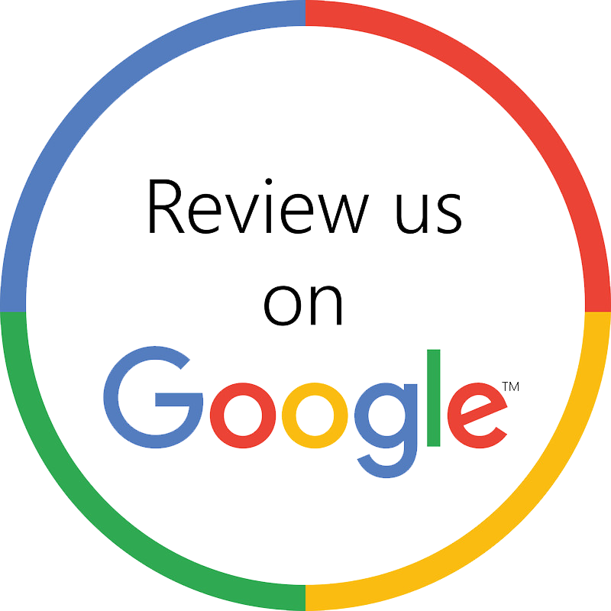
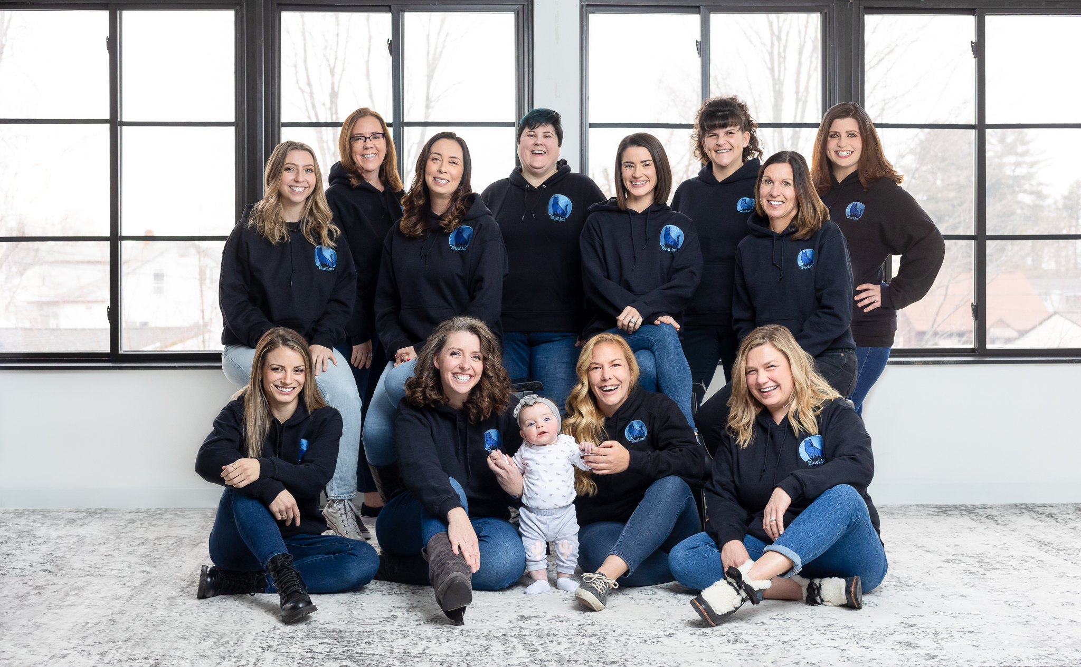
Thank You | Connect with Us
(603) 818-4131
info@bluelionllc.com
Social Media:
Instagram: @bluelion_llc
Twitter: @bluelionHR
Facebook: @BlueLionLLC
LinkedIn: BlueLion, LLC
Follow us on social media!
@bluelion_llc
@bluelionHR
@BlueLionLLC
BlueLion, LLC
BlueLion, LLC

