Slide 1
Give your prospects a Speed Dial directly to YOUR business

Slide 2
Questions to be answered
What should you expect to get out of this discussion?
What is #250 and what challenges does it help to address for my business?
Is it affordable?
Is there a proven track record and how would it fit into my overall marketing strategy?
Are there examples where #250 has provided tangible benefit?
Is this applicable to my business? If so, what is needed to get started?
2

Slide 3
What is #250
And what could it do for my business?

Slide 4
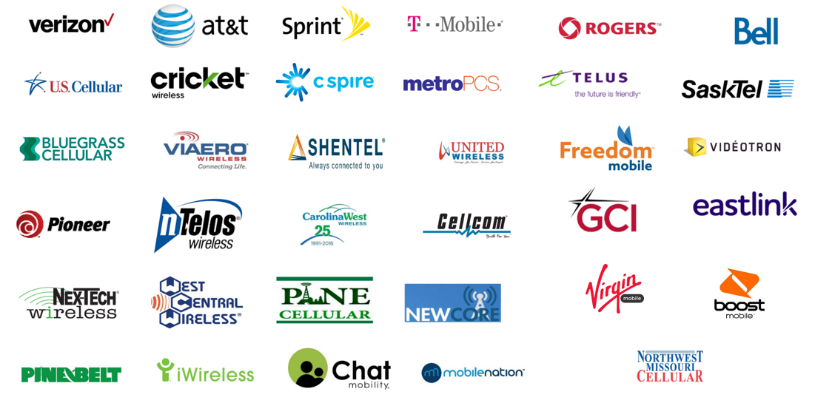
What is #250?
A one-of-a-kind mobile speed dial that works right now on virtually all mobile phones in the US and Canada
A replacement for hard to remember toll-free or local phone numbers
Intelligent voice recognition technology used to connect prospect to advertiser
No need for apps, phone numbers, website URLs, texting in a keyword, or Google
Make it EASY for your customers and prospects to reach you immediately!
Notes:
On the top deck, this product has a cool interface with customers and prospects and a slick dashboard for your business.
But below deck, there are a bunch of technologies that have been pieced together. Of course it all starts with the fact virtually every mobile carrier in the US and Canada having worked with us to ensure the short dialing code #250 does the SAME thing regardless who dials the number.
It combines technology vendors offering intelligent voice recognition, gross location detection, call trend detection and analysis, configurable call routing technology, response analytics dashboard, and much more.
When combined, we produce a smooth call experience that cannot be matched to get people who have an issue with their current garage doors connected directly to a GDF member in their area in seconds.
As you probably already know, when you have a skilled person on the phone answering questions and selling your products/services, your close rate is 20x that of web searches.

Slide 5
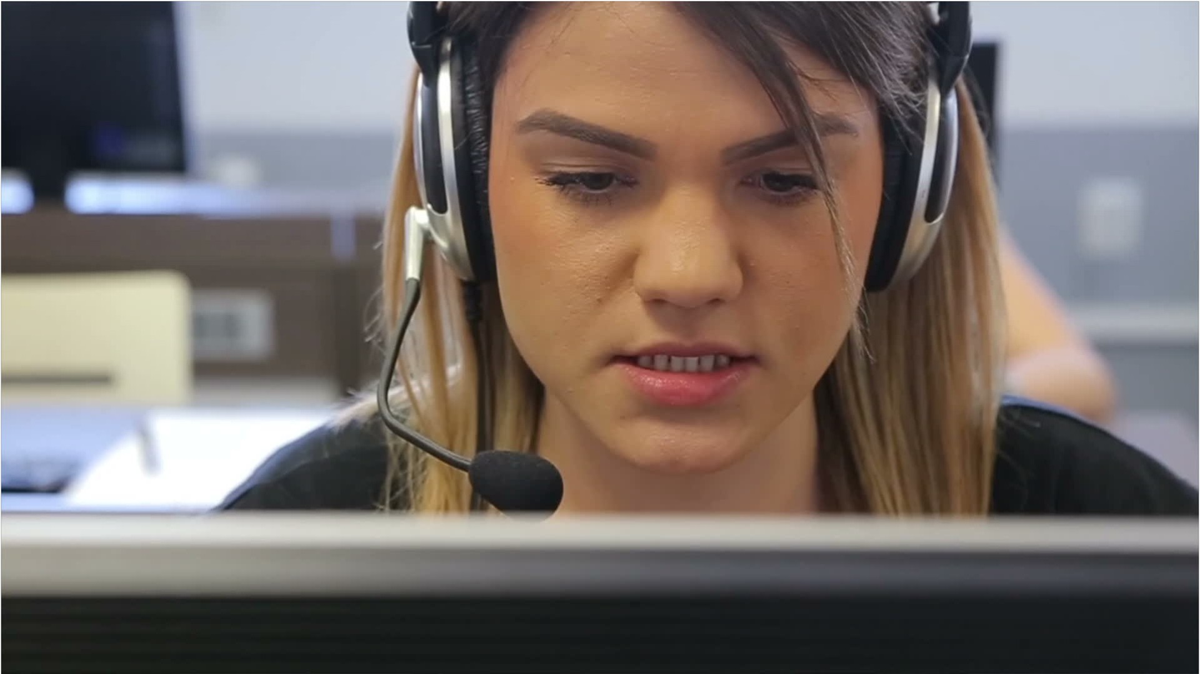
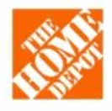
Shield your prospects from competitors
Garage Door Installation Competitors
5
Notes:
Buying search terms and SEO optimization is typically a significant part of any Home Services busineses marketing budget and strategy, rightfully so!
Being at or near the top of Google search results is important! And not being visible to prospects in those searches is bad.
So what does this mean? Your business success depends on people finding your business when a need for your products/services arises.
But when you advertise your business, do you want people to have to Google your business to connect? NO – that just exposes your prospect to the competition. You want them to have an easy method to reach your business without having to jump through hoops!
#250 sends your prospects through a tube directly to your business and completely shields them from view of your competitors

Slide 6
Is it affordable?
with the negotiated GDF rate, it is a few dollars a day

Slide 7
Proven track record?
Who uses this and what have been the results?

Slide 8
Adding Value Since 2015
What is #250’s history?
#250 has been widely used on satellite radio, local radio, TV, billboards, podcasts, and other types of media for almost a decade.
Over 1,000 companies have generated more than 1.3 million calls since 2016.
iHeartMedia has trusted #250 for the last 8 years to help increase the number of calls their clients receive as a result of their advertising.
Home security company revitalized its advertising strategy using #250 to deliver over 100,000 calls since 2016
Garage door company used #250 to drive over 9,000 calls from 2016 to 2021 until the pandemic changed things
Home insulation company uses #250 to drive excellent ROI on cost per lead (approximately 6,000 leads over the last 5 years)
Any Success Stories?
8
Confidential & Proprietary

Slide 9
Applicable to my business?
What’s involved to get started?

Slide 10
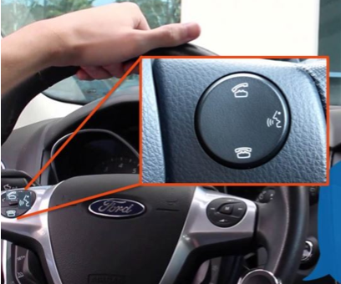
Don’t make people jump through hoops!
Dial #250
Say the Brand Keyword or scan a QR code
Connect
10

Slide 11
Think about the creative call-to-action in so many ad campaigns...
why are we asking the listener to respond in this way???
People are busy doing life on the go!
They can’t go to a website
They can’t text a keyword
They can’t remember a phone #
Can’t even dial a vanity phone #
11

Slide 12
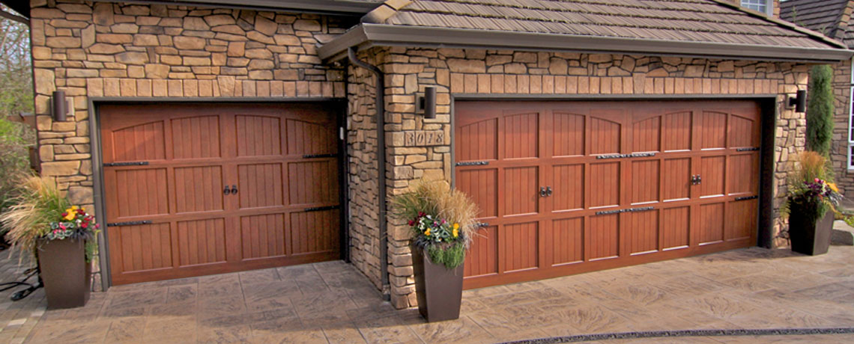
QR Codes Connect prospect directly to your call center through the #250 platform!
Custom Garage Doors

Slide 13
People typically to take action within 3-minutes…so removing all barriers to response is essential
We connect more prospects because they can easily respond, even when busy or distracted
More than 91 percent of calls hit our platform within 180 seconds
The impulse to respond dissipates quickly, so don’t present any barriers to immediate response
Past formal A/B split test resulted in 79% more calls on #250 over the toll-free number
It’s just common sense…remember
Humans cannot remember 10-digit phone numbers
They cannot dial vanity or partial vanity numbers while driving
They cannot visit your website while driving
BUT they can EASILY push the BlueTooth button and say DIAL #250 and say your KEYWORD to connect immediately – or scan a QR code on the side of your truck to be directly connected!
13

Slide 14
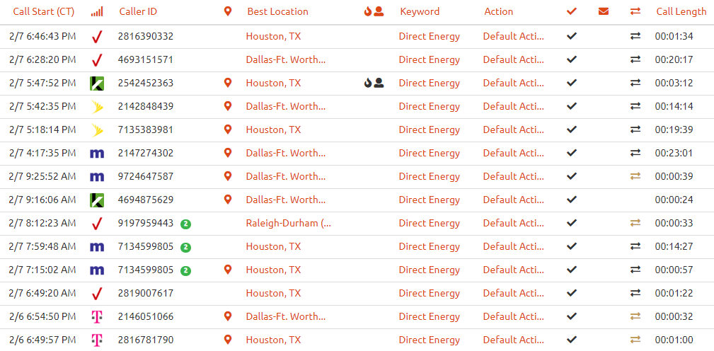
Robust inbound call-handling features included
Robust call-handling platform
Custom audio greeting
Direct caller to nearest location if multiple locations
Time of day call handling
If no answer, take message, email voicemail to distribution list
Put contact information in caller’s phone or links to schedule appts
Track all calls in online portal
Monitor call-handling and customer service
Integrate with CRM
14

Slide 15
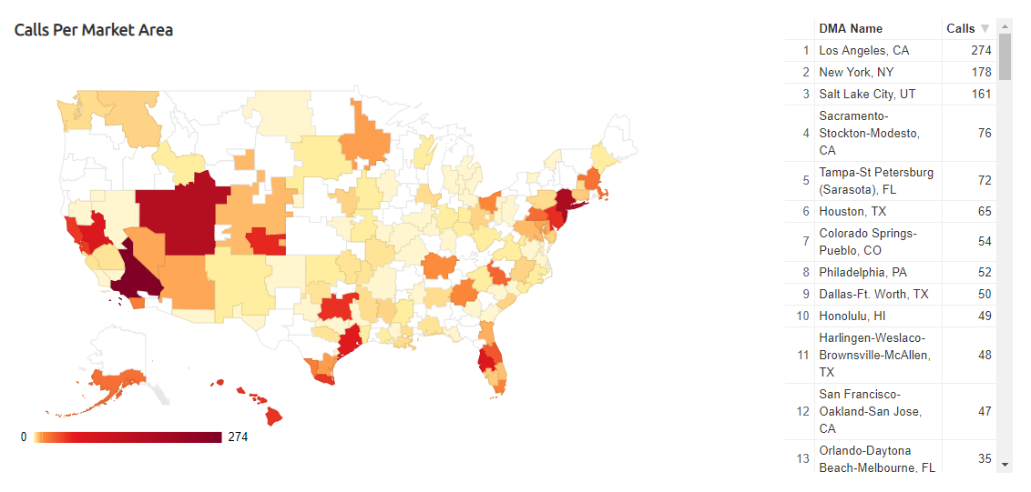
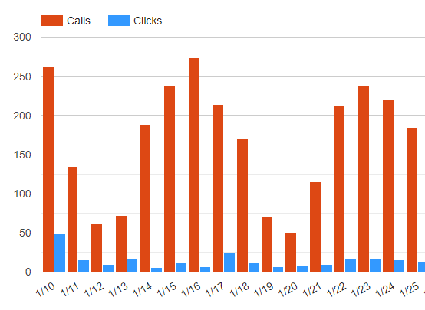
Realtime Tracking & Analytics
Dial #250
Say the Brand Keyword
Connect
15

Slide 16
Category and Brand Keywords
GDF Members will effectively ‘own’ the Garage Doors category in reserved market service areas
Category Keywords included:
Garage Doors
Garage Door Installation
Overhead Doors
Garage Door Freedom
Garage Door Freedom Group
Brand Name Keywords also available
Company Name (e.g., Alpha Garage Doors)
16

Slide 17
Special GDF Pricing
GDF Members receive a 10 percent discount off standard pricing below
Cancel anytime without penalty
Annual agreement billed every 6 months
$5 per county with a $100 monthly minimum per service area
*No set-up costs or cost per lead​
17

Slide 18
That’s cool, but why is it relevant to me?
You have a LOT of competition in the Home Services world!
Every incremental new customer is important
You’re probably already dominating with your digital strategy, but there are more leads to get
Today’s homeowners are always on the go, which is an opportunity to capture their interest beyond Google search
Audio advertising (radio, podcast, and streaming) is an excellent way to expose your brand to a very broad audience of homeowners, many of whom need garage door services
While on the move, homeowners drive by your service vans, see their neighbors getting new doors, etc.
Truck wraps, yard signs, and other signage are good ways to attract the attention of on-the-go homeowners
Would you spend ~$3 per day to capture net new leads beyond your current marketing methods?
#250 Home Services Video
18

Slide 19
Simple Signup Process
GDF Members can secure their respective market service areas on a first come, first served basis
Send email to support@pound250.com with a list of counties in the market service area
You will receive a price quote and simple agreement to sign
Your market service area will be activated and ready within 24 hours
19

Slide 20
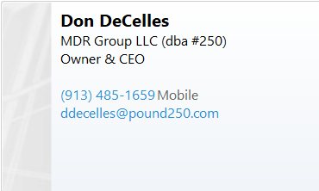
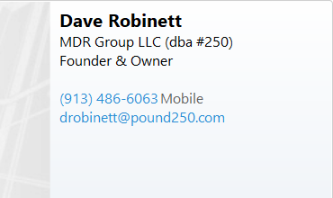
Q & A
20

