Slide 1
Project Leadership-202

Slide 2
Review: Project Leadership 101
Projects vs. Day-to-Day tasks
Identifying Projects
High or Low Effort vs. High or Low Impact
Gantt Charts/Project Tools
Beware of Distractions

Slide 3
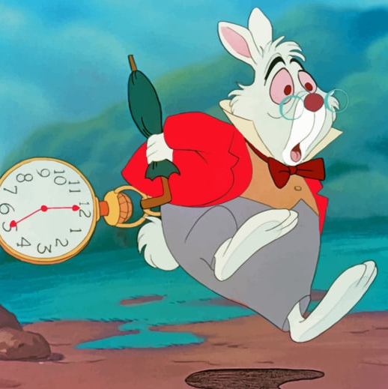
Project Planning… is a temporary sequence of activities that is aimed at a particular goal.
Timeline or Lifecycle is the temporary period over which a project is executed.
Resources are the considerable allocation of money, personnel, and equipment needed to complete this goal.
Tasks are the activities that need to be accomplished in the project to get it to completion.
Goals are the specific unique products, services, or results intended to be created by this focused efforts. Typically, this is an INVESTMENT, in your future growth or to resolve a current challenge in the business.

Slide 4
What’s Next?----Project Leadership 202
How to have the project planning meeting
How to identify resources and leaders to execute goals
Delegation 101
How to fill out a Gantt Charts for a project
SMART Statements: X to Y By When

Slide 5
Project Planning Sessions
Identify the Goal or Outcome you want the project to have?
Identify the resources including the costs needed for the project.
Define the tasks or steps it will take to accomplish the task.
Define the realistic timing you believe this project will take to complete.
EVALUATE—does this project makes sense now knowing the facts?
Initiate the project by conducting a roll out meeting with the resources needed.
Assign the tasks
Monitor the progress on a regular basis

Slide 6
Identifying Resources
Identify the Task
Make a list of tasks
Understand the ask
Who is available?
Focus on the task; not the role
Divide & Concur
Timing
Measurable
Specific

Slide 7
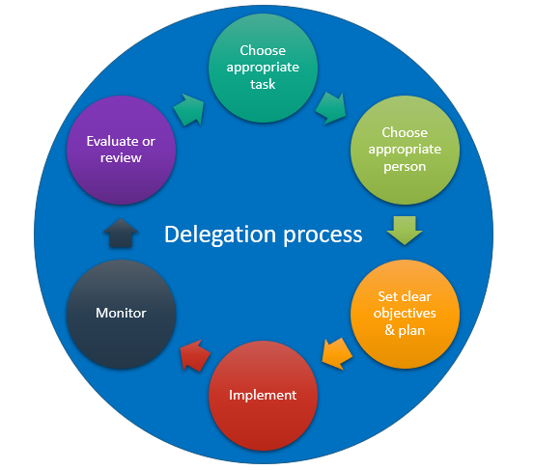
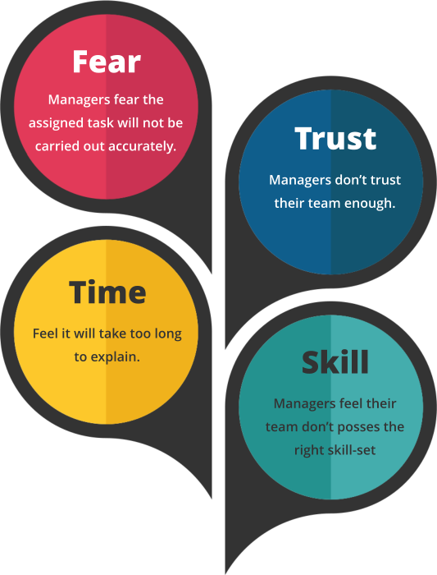

Slide 8
Gantt Charts
What is a Gantt Chart and why is it used?
A Gantt Chart is a project management tool that illustrates work completed over a period in relation to the time planned for the work. It typically includes two sections: the left side outlines a list of tasks, while the right side has a timeline with schedule bars that visualize work
Benefits of using Gantt Charts: easy to schedule tasks, easy to understand and provides clear visual representation of time frames.
Let’s build one together! Simple Gantt Chart1.xlsx

Slide 9
Wildly Important Goals (WIG Goals)
WIG Goals are expressed statements that are specific, measurable, and time-bound. Creating WIG Goals is a discipline that narrows your focus to a few highly important goals so you can achieve them in the midst of the WHIRLWIND of the day-to-day job. If you want to create a high focused TEAM, then they must have something WILDLY important to put their focus on!
The 4 Disciplines of WIG Goals
Focus on the Wildly Important (these can be company-wide goals or team/department specific goals)
Act on the Lead Measures (what is being done to move the needle)
Keep a Compelling Scorecard (make it visible for the entire company, team or department to see)
Create a cadence of accountability (discuss WIG goals consistently during team meetings and hold people accountable)

Slide 10
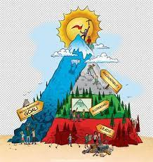

Slide 11
SMART Statements: X to Y By When
In order to achieve your Wildly Important Goals, you need to recognize where you are today, where you want to go and the deadline to reach the goal; therefor, creating an X to Y by When statement. X to Y by when statements must be specific, measurable and time-bound.
Examples of WIG Goals formatted in an X to Y by When Statement
Increase average repair ticket from $__________to $________ by December 31, 2023
Roll out Service Titan to Field Techs by April 1, 2023
Complete the pole barn to house our equipment by May 31st
Conduct the first project planning meeting to evaluate our next project by May 20th

Slide 12
Avoid the Whirlwind and Clear the Path
Whirlwinds are existing work and urgent tasks that need attention now! Day to day items/emergencies that take away your focus on moving the team forward on the Wildly Important Goals. To prevent this, you need to CLEAR THE PATH!
While Whirlwinds consist of essential day-to-day activities that keep the business running, are they being handled by the correct people?

Slide 13
Break Outs-15 Minutes
Discuss the Project
Define the Goals of Project
Create WIG goals for each Project in your group
Develop the X to Y statement to support the WIG
BONUS: Identify potential whirlwinds

Slide 14
SUMMARY
Designate time to invest in Project Planning Sessions
Create the Plan by putting it down in a tracking tools (Gantt Chart)
Teach your team to speak in SMART specifics (X to Y By When)
Identify and empower your resources to run projects & execute goals

