Slide 1
Project Leadership

Slide 2
Self Check…
Am I ON my business or IN the business?
What dictates a project vs. a day-to-day task?
What challenges are associated with completing a project successfully AND on budget/time?

Slide 3
Projects vs. Day-to-Day Tasks
Learn to ask yourself these questions:
Is this a daily task or one associated with a focused temporary effort?
Who should be handling this specific task?
Am I working on the business or in the business?
What benefits, both short and long term, will I gain from my efforts?
From our Survey: How do you decide if a "Project is a Project" or if it is a "Day to Day Activity"?
“A project has a defined objective and end point and often happens once. It is unique and not part of a standard process or workflow. Often it requires additional people, resources, and effort to coordinate. Day to day activities are recurring and standardizable processes tied to a particular timeframe.” -Martin Madden Overhead Door Systems

Slide 4
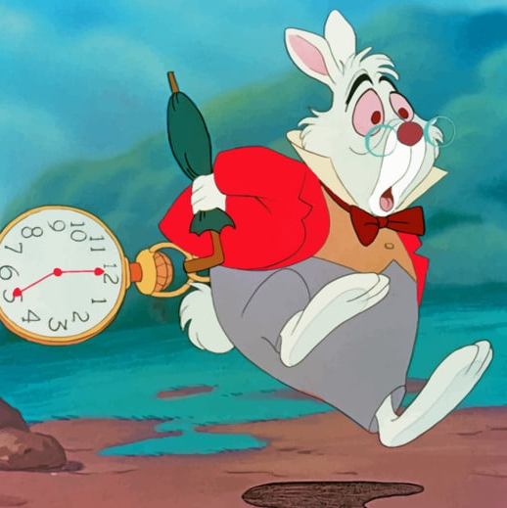
Project Planning… is a temporary sequence of activities that is aimed at a particular goal.
Timeline or Lifecycle is the temporary period over which a project is executed.
Resources are the considerable allocation of money, personnel, and equipment needed to complete this goal.
Tasks are the activities that need to be accomplished in the project to get it to completion.
Goals are the specific unique products, services, or results intended to be created by this focused efforts. Typically, this is an INVESTMENT, in your future growth or to resolve a current challenge in the business.

Slide 5
TO ADD IDEAS
Identifying projects / how to identify projects

Slide 6
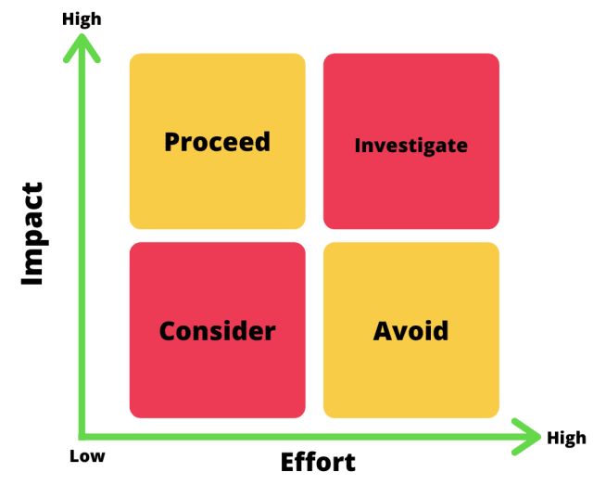
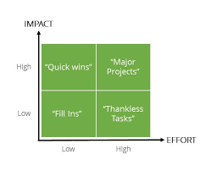
Action Priority Matrix

Slide 7
Sample Action Priority Matrix
QUICK WINS
MAJOR PROJECT
HIGH
IMPACT
FILL INS
THANKLESS TASKS
LOW
LOW
EFFORT
HIGH

Slide 8
Action Priority Matrix
What is an Action Priority Matrix?
An action priority matrix is a visual diagram that helps teams focus on individual tasks by prioritizing them. By separating and prioritizing tasks, teams can focus their attention and resources where they’re most needed, completing individual tasks or larger projects in order of importance.
How to use an Action Priority Matrix
Create a list of activities and tasks that you are currently working on
Assign an impact and effort score to each item. Consider the effort and impact that each items has on the project. Items that require a lot of resources, time and money will score higher in effort.
List your items in their correct squares. Items that require a lot of effort but have a minimum impact are in the bottom right square, items that require minimal effort but have a larger impact will go in the top left square. Everything else fits in between those squares on the spectrum of effort and impact.
Complete tasks in order of importance. You can adjust the scores for each task as the project progresses and priorities change.

Slide 9
Sample Action Priority Matrix
Creating a chore chart for the kids
Replace the HVAC
Creating a chore chart for the kids
Turn basement into office
Replace the HVAC
Reorganize the closet
Paint accent wall in kid’s room
Set up emergency plan for family
Turn basement into office
Shovel the driveway
Set up emergency plan for family
Shovel the driveway
Fold the laundry
Scrub the floors
Install a pool
Re-seal patio deck
Re-seal patio deck
Install a pool
Reorganize the closet
Paint accent wall in kid’s room
Fold the laundry
Scrub the floors

Slide 10
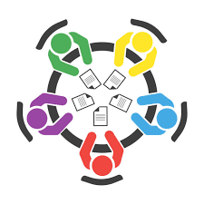
Group Break Out Session
Action Priority Matrix
Create a list of 5-10 projects as a group
Prioritize them based on your efforts vs impact to your business
Plot each project on the Action Priority Matrix
Determine which 2-3 projects you should work on immediately
BONUS: Pick one project and determine the resources, time needed to complete, and goal of the project.

Slide 11
Common Project Challenges

Slide 12
Gantt Charts
What is a Gantt Chart and why is it used?
A Gantt Chart is a project management tool that illustrates work completed over a period in relation to the time planned for the work. It typically includes two sections: the left side outlines a list of tasks, while the right side has a timeline with schedule bars that visualize work
Benefits of using Gantt Charts: easy to schedule tasks, easy to understand and provides clear visual representation of time frames.
Let’s build one together! Simple Gantt Chart1.xlsx

Slide 13
A white board where you can jot down project ideas
Gantt Charts or a tracking software
Calendar/Outlook-Set dedicated time aside for projects
Book: The One Minute Manager Meets the Monkey by Kenneth Blanchard

