Slide 1


Slide 2
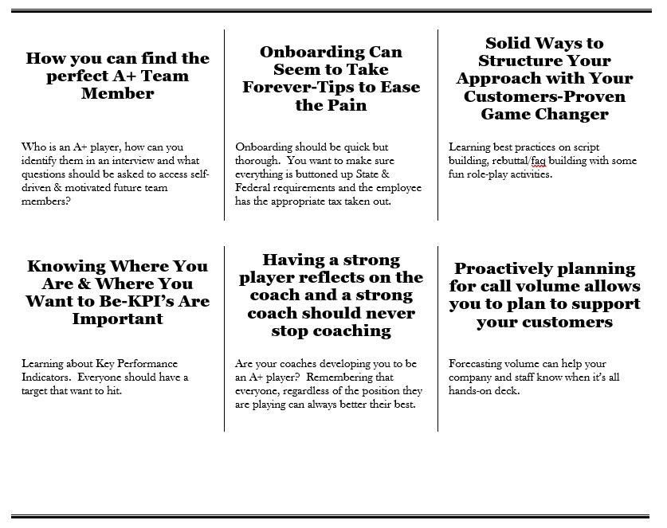
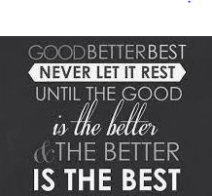
What We Will Be Unlocking For You Today
Notes:
Our focus today is on how you can better your best with all things Call Center! Whether you have a small shop with only 1 person answering the phones or you have a handful of people answering the phones, we can all agree that your ultimate goal is to grow your business. What does that mean….Not only will you need more technicians out in the field supporting your customers but also you’ll need more associates answering the phones.
Things We’ll Be Reviewing Today:
How you find A+ Team Members
Tips to ease the pain of onboarding
How to build out scripting, FAQ’s and Rebuttals
Learning about how to build out Call Center KPI’s
Measuring and Coaching to improve performance
And last but not least, how to proactively plan for call volume
So often we start our work day off with looking at all the stuff we need to get done in a day to WORK ON THE BUSINESS and then the emails and phone calls start coming in. We jump into ‘FIREFIGHTING MODE’ and by the end of the day we never worked on how to work on ‘FIRE PREVENTION’. I want to THANK YOU for giving up some time out of your busy day so you can work ON THE BUSINESS.

Slide 3


How You Can Find The Perfect A+ Team Member
GDF Members-Share You Knowledge
Who Are A+ Players
Can You Spot A Professional Interviewer?
What Questions Can You Ask To Access Self Drive & Motivation
Page 2 In Workbook
Notes:
I’d like to hear from our GDF Members!
Who wants to share an example of ‘Who An A+ Player Is’. I’m looking for 3 volunteers to share. As a disclaimer if this group is shy, I’m going to have Crystal pick on a few people so be ready.
Raise your hand on zoom if you know how to spot a professional interviewer? [note to presenter: who ever raises hand, ask them to give an example]
Can someone give me an example of what questions you ask or could ask to access if the candidate is a self-driven individual and has motivation to continue to push the needle. Same disclaimer as before. If we don’t get anyone jumping in, I’m going to have to call out the big guns and have Crystal pick someone out of the crowd.
Pro Tip:
Have they ever had to sacrifice something to grow?
Played sports in High School
Worked while going to school and maintaining good grades
Single Mom/Dad pushed themselves to better their situation
The next section we’ll be looking at the interview process from a candidate's point of view.

Slide 4



How You Can Find The Perfect A+ Team Member
Page 3 In Workbook
Questions To Ask Yourself-Candidates Point Of View
Questions
Hiring Manager-Things To Note
Have you ever experienced starting a new job and feeling so welcomed? What did the company do to make you feel that way?
You should have the same passion you put into providing your customers with an EXCEPTIONAL experience!!!!!
Have you ever read a job description and felt it was the perfect fit and just hoping they would give you an opportunity to interview to show them what you can offer them?
There’s something to say about giving your job description a mic drop!
Looking For A Job Is So Nerve-racking. I Just Want To Find A Company That Values What I Can Bring To The Table.
I Just Need An Opportunity To Interview With Them!
What makes you want to leave a company?
Leadership not being transparent, following through on commitments, not showing respect and appreciation. It’s more than just pay and benefits.
When you’ve applied for positions in the past, what have you looked for out of the company?
What made you apply? What made you happy? 100% Emotional!
What made you accept ‘The Offer Letter’?
There’s very few people that say, ‘No specific reason, I just need a J.O.B’. Something made them say, ‘OK, let’s do this’. What are reason you stay, or your employees stay? STAY AWAY FROM CANDIDATES THAT ARE JUST LOOKING FOR A J.O.B!!!!!!
What makes you stay at a company?
Even though pay and benefits are very important, it’s the people you work around that makes you stay or leave!
Notes:
If I could get 2 volunteers to play reading parts.
One person will read the Questions section and one will read the hiring manager things to note
Crystal-If you can watch the hands and pick the first 2 team members!

Slide 5

How You Can Find The Perfect A+ Team Member
Page 3 In Workbook
Questions To Ask Yourself-Hiring Manager Point Of View
Questions
Hiring Manager-Things To Note
Do you keep your postings updated?
Always be recruiting & looking for the best of the best.
Do you have a list of question you ask that allow you to know if your candidate is a self driven/motivated individual?
Questions should be focused around breaking the ice & having their true personality come to the surface.
I Know The Type Of Person I Want On My Team. My Fear Is Hiring The Wrong Person!
Are you respecting that the candidate? They are also interviewing the company?
This is your time to shine and let them know who you are looking for on your team and how you run your shop. Get them excited and hoping that you pick them.
How are you evaluating the candidate?
It’s OK to have a 2nd interview or follow up. Hiring someone should NOT be considered a task. You should consider it one of the most IMPORTANT decision you’re making for the company.
Do you have a job description for all positions in the company?
Run your business pro-actively and be ready at any given time.
Do you have a position manual or full training playbook for all positions?
It’s important that you and your team know what to expect from the beginning. This should be clearly documented and outlined before posting a job.
Are you leveraging creative ways in your ad to draw attention?
Have fun and get creative with your ads and always be finding ways to improve.
This is more than when just letting then know when the company started and what you do. It’s letting them know what matters to the organization and what your team values and how they achieve success.
Are you educating the candidate on your company, culture & expectations?
Notes:
If I could get 2 volunteers to play reading parts.
One person will read the Questions section and one will read the hiring manager things to note
Crystal-If you can watch the hands and pick the first 2 team members!

Slide 6


How You Can Find The Perfect A+ Team Member
Page 4 In Workbook
Pro Tips
Always Be Recruiting
Bring Your Candidates Personality & Passion Out In The Interview
Always Be Recruiting!!!
Ask Yourself If You Candidate Is Self Driven & Self Motivated
Make Sure Your Candidate Knows About Your Company
Remember That It’s OK To Have A Follow Up Interview
Be Ready With Job Descriptions Written Out For All Positions
Have Manuals Built Out For All Positions
Get Creative With Your Job Ads-Also Make It Easy For A Candidate To Apply
Have Respect For The Candidate Through The Process

Slide 7
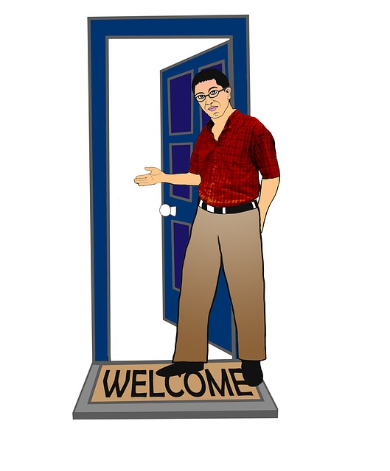

Ease The Pain Of Onboarding
GDF Members-Share You Knowledge
Page 5 In Workbook
Who Has An Onboarding Process They’d Like To Share?
35% of companies have no formal onboarding program [Source: Urbanbound]
69% of employees are more likely to stay with a company for 3 years if they experienced a great onboarding experience [Source: O.C. Tanner]

Slide 8
Ease The Pain Of Onboarding
Page 6 In Workbook
Questions To Ask Yourself-New Employee Point Of View
Questions
Hiring Manager-Things To Note
What have been some of your best experiences with onboarding with a company?
Welcome Goodie Box, Desk/Office & Space Already Set Up & Ready To Go, Make Them Joining The Team A BIG DEAL!!!
Please let me know what I can expect through the onboarding process and keep in communication with me!
Always be respectful that your candidate is probably anxious to start working. Don’t skip steps, but don’t drag it out because you don’t have things ready for them yet. BE PRO-ACTIVE!!
How long do you feel the onboarding process Should take?
Have you ever turned down a job because the onboarding took to long?
Remember that your candidate may have accepted your offer, but until you have fully onboarded them and they’ve started working YOU RISK them accepting a different offer.
Notes:
If I could get 2 volunteers to play reading parts.
One person will read the Questions section and one will read the hiring manager things to note
Crystal-If you can watch the hands and pick the first 2 team members!

Slide 9
Ease The Pain Of Onboarding
Page 6 In Workbook
Questions To Ask Yourself-Hiring Manager Point Of View
Questions
Hiring Manager-Things To Note
When do you let your candidate know, they got the job?
You’re probably not the only company that they are interviewing with!
I have SO MUCH stuff I must get done to get the new team member up and running. I wish I had time to work on this!!!!!
This is your way to formalize & document what you are promising to your new team member.
Do you have a formal offer letter that you present to the candidates?
When do you present the offer letter?
The sooner the better. Some candidates need this piece of mind that their position is secured before giving notice OR to officially stop their job searching.
Do you explain what to expect during the onboarding?
I-9, Tax Forms, Signing of the Offer Letter & signing off on other important documents.
Do they know what to expect for Day 1?
We all get a little nervous, not knowing what to expect, where to go, who to report to, what to bring & details of day/time of Day 1.
Notes:
If I could get 2 volunteers to play reading parts.
One person will read the Questions section and one will read the hiring manager things to note
Crystal-If you can watch the hands and pick the first 2 team members!

Slide 10
Ease The Pain Of Onboarding
Page 7 In Workbook
Pro Tips
Remember that your potential new employee is probably interviewing with other companies
Make sure you have a formal offer letter template created for all your positions
Candidates need piece of mind that they ‘Got the Job’. For some people verbal is ok but for most they want to see it in writing
Time is of the up most importance when you find the right team member. Don’t take advantage of their time, they are probably ready to jump in
Make sure your backyard is leaned up and you’re onboarding your staff through all formal State/Federal requirements
It’s important that you are educating your new team member all the way through the onboarding process, so they don’t feel forgotten about
Make your new team member feel valued and special by making sure they have a clean and prepped work area including all necessary computer equipment and access to program/software applicable to their position.

Slide 11

How You Can Find The Perfect A+ Team Member & Onboarding Them
Page 4-7 In Workbook
Breakout Session
Breakout Session Time
15 Minutes
Breakout Session Instructions
1.) Share With Your Group What You Do Or Would Like To Do That Improves The Interview Process On Both Sides
2.) Share With Your Group What You Do Or Would Like To Do That Improves The Onboarding Process On Both Sides
Notes:
Let’s jump into a breakout session!
Crystal will divide the team
The breakout session will last 10 minutes
The purpose is to share with the group what you do or would like to do to improve your interview process and your onboarding process.
Use page 4-7 to take notes

Slide 12
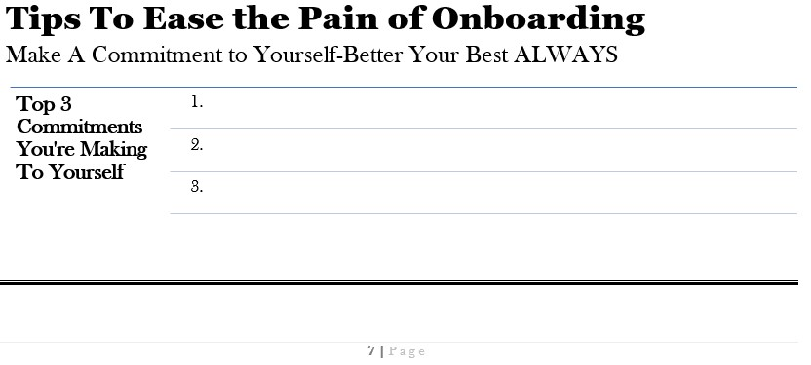


How You Can Find The Perfect A+ Team Member & Onboarding The
Breakout Session-Regroup
GDF Members-Share You Knowledge
Notes:
Does any one of the groups want to share some ideas?
Take a few minutes to write down a few of your commitments for interviewing and onboarding.

Slide 13

Solid Ways To Structure Your Approach-New Hire Training
GDF Members-Share You Knowledge
Do You Have Your Training Material Dialed In?
Are You Taking The Time To Work On The Business With Polishing Your Training?
Are You Leveraging Technology To Improve Efficiencies?
Do You Ask Your Employees On A Regular Basis What Would Help Them Accelerate Training?
Do You Ask Your Team On A Regular Basis What Their Pain Points Are With Processes?
Page 8 In Workbook
Notes:
We have 5 questions we want you to think about. Each question, we’d like 1 volunteer to answer. Remember there are no wrong answers, just honest answers!

Slide 14

Solid Ways To Structure Your Approach-Training
Questions To Ask Yourself
Questions
Hiring Manager-Things To Note
Do you remember being a new employee and the company was dialed in with their training or it was fly by the seats of their pants?
Being organized & dialed in with your training, shows your new employee that you truly care about setting them up for success.
I don’t know what I don’t know! I hope they aren’t setting me up to fail.
I’m so frustrated!!!! How many times do I have to answer the same questions, I told them how to handle this process 5 months ago. This isn’t a new process.
Have you ever experienced a training that has fun activities that help you retain the information & make it fun?
Activities should be thought out and focused to help the trainee retain the information and learn without feeling that it’s a talking head training.
Remember that each person has different learning styles. Your training should have a good mix of presenting, activities, check point assessments, visual and interactive modules.
What has been your experience with learning through visual instruction?
Homework Assignment
Page 9 In Workbook
Provide Your Employees ‘Training Material-Check Point Assessment’
Notes:
If I could get 2 volunteers to play reading parts.
One person will read the Questions section and one will read the hiring manager things to note
Crystal-If you can watch the hands and pick the first 2 team members!
Homework assignment-Page 9 For You And Your Employees

Slide 15

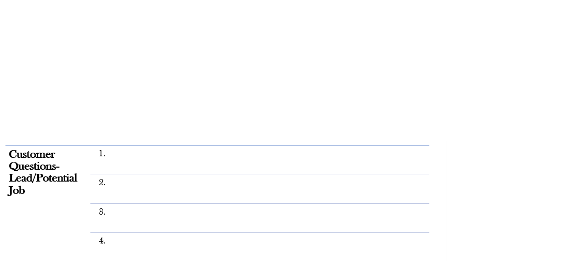




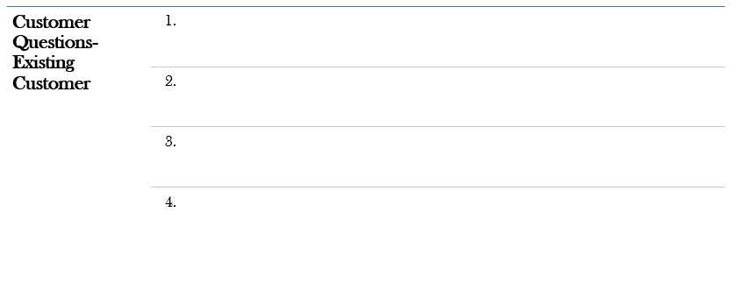

Solid Ways To Structure Your Approach-Training
Understanding Your Customers
Let’s Jump Into Another Activity.
❶This Will Be A Silent Study Activity
Mute Mic During Activity
❷Go To Page 11 In Workbook
❸Separate Out Your Customer Types
Lead/New Customer vs. Existing Customer
❹Write Down Customer Questions Or Requests
❺Activity Is 10 Minutes
Notes:
It’s time for another activity.
During this activity, everyone will stay on this zoom group, but they will mute their mic.
Turn to page 11 of your workbook
Write down your customer questions/requests into 2 separate groups (1=Customer Leads/Potential Jobs & 1=Existing customers with questions).
This silent study activity is scheduled for 10 minutes
Any questions before we begin?

Slide 16

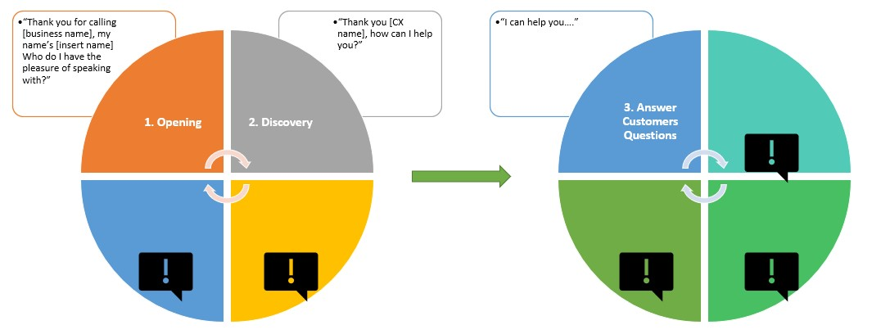
Solid Ways To Structure Your Approach-
Script Flow-Losing Call Control
Understanding How Calls Can Get Off Track
Page 12 In Workbook
Raise Your Hand If You Have Challenges With Overcoming Pricing Questions
Your Script Flow Should Be An 8 Step Process Before Answering Questions
Most Companies Run Into Problems Because They Skip So Many Valuable Steps
This Section Of The Webinar Is Going To Show You How You Lose Call Control & How To Maintain Call Control
If You Aren’t Prepared, You Will Lose Control Of The Call
Notes:
Your script flow is typically an 8 step process. Most companies run into problems because they skip so many valuable steps. This section of the webinar will be focusing on how you lose call control and how you can gain it back.
-Losing call control generally happens at the beginning of the call when you ask ‘How Can I Help You’ and then you go straight into answering the customers questions.
-Raise your hand if you have challenges overcoming giving price?
-Raise your hand if you have challenges with customers giving you the ‘I’ll call you back’
The DANGER ZONE is directly after you ask ‘How Can I Help You’. Everything you do should be done consciously and with intent. If you don’t follow the basic 8 steps, you are losing potential revenue from unbooked jobs.
Let’s jump into what this sounds like (next page)

Slide 17



Solid Ways To Structure Your Approach-
Script Flow-Losing Call Control
What Does Losing Call Control Look Like
Page 12 In Workbook
Thank your for calling Garage Door Freedom?
Yes, I have a broken spring and I’m needing some pricing!
OK, it all depends on your set up. Is this a standard overhead garage door?
I believe so
Our labor rate is $125, and springs are approximately $250.
Thanks, I’ll need to let my husband know and then I’ll call you back.
OK, thanks for giving us a call. Have a nice day
Does This Look Familiar? Who’s In Controlling The Conversation?
Notes:
Crystal and I are going to do a quick role play. Keep in mind any pricing given or questions asks are very general.
Crystal will be the customer and I’ll be the agent

Slide 18
Solid Ways To Structure Your Approach-
Script Flow-Maintaining Call Control
What Does Maintaining Call Control Look Like
Page 13 In Workbook
Thank you for calling Garage Door Freedom. This is Angela, who do I have the pleasure of speaking with?
My name’s Crystal
Hi Crystal, how can I help you?
Angela, I have a broken spring and I’m calling around to get pricing!
First off Crystal, I’m sorry to hear you have a broken spring, you’ve called the right place I can help you. Have you ever used our services before?
I haven’t. This is the first time I’ve had anything happen to my garage door.
Who’s In Controlling The Conversation?
Thank you, Crystal, for thinking of us for your garage door needs. When are you looking for one of our technicians to go out and look and provide you pricing?
Notes:
Crystal and I are going to do a quick role play. Keep in mind any pricing given or questions asks are very general.
Crystal will be the customer and I’ll be the agent

Slide 19
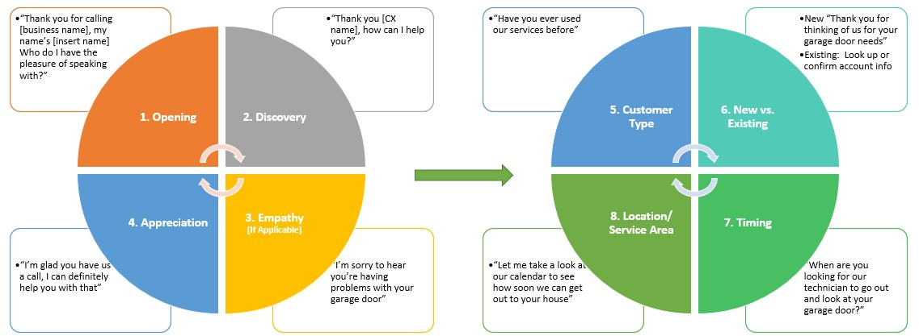
Solid Ways To Structure Your Approach-
Script Flow-Maintaining Call Control
Are You Ready To Gain Call Control
Page 13 In Workbook
Maintaining Call Control Is Key To Overcoming Objections & Answering Customers Questions
Notes:
Opening=Brand the call, announce yourself and ask for the callers name (I call this the name game). It’s important that all 3 components are represented in part 1
Discovery=Repeat customer name (you are acknowledging them) and ask them how you can help them
Empathy=(when applicable) let them know you’re sorry to hear they’re having problems with their garage door
Appreciation=Show your potential customer appreciation, they could have called anyone but they called you
Customer Type/New vs. Existing: Find out if they’ve ever used your services before. It never hurts to offer a 2nd appreciation statement. Also if you have any spiffs you give to new customers, now is when you can let them know (help reduce cancellations)
Timing=Find out when they are looking for you to come out. If you’re tight on capacity remember that it may not be urgent for them and you can use this to prioritize your jobs
Location=Take a look at your capacity based on their location

Slide 20
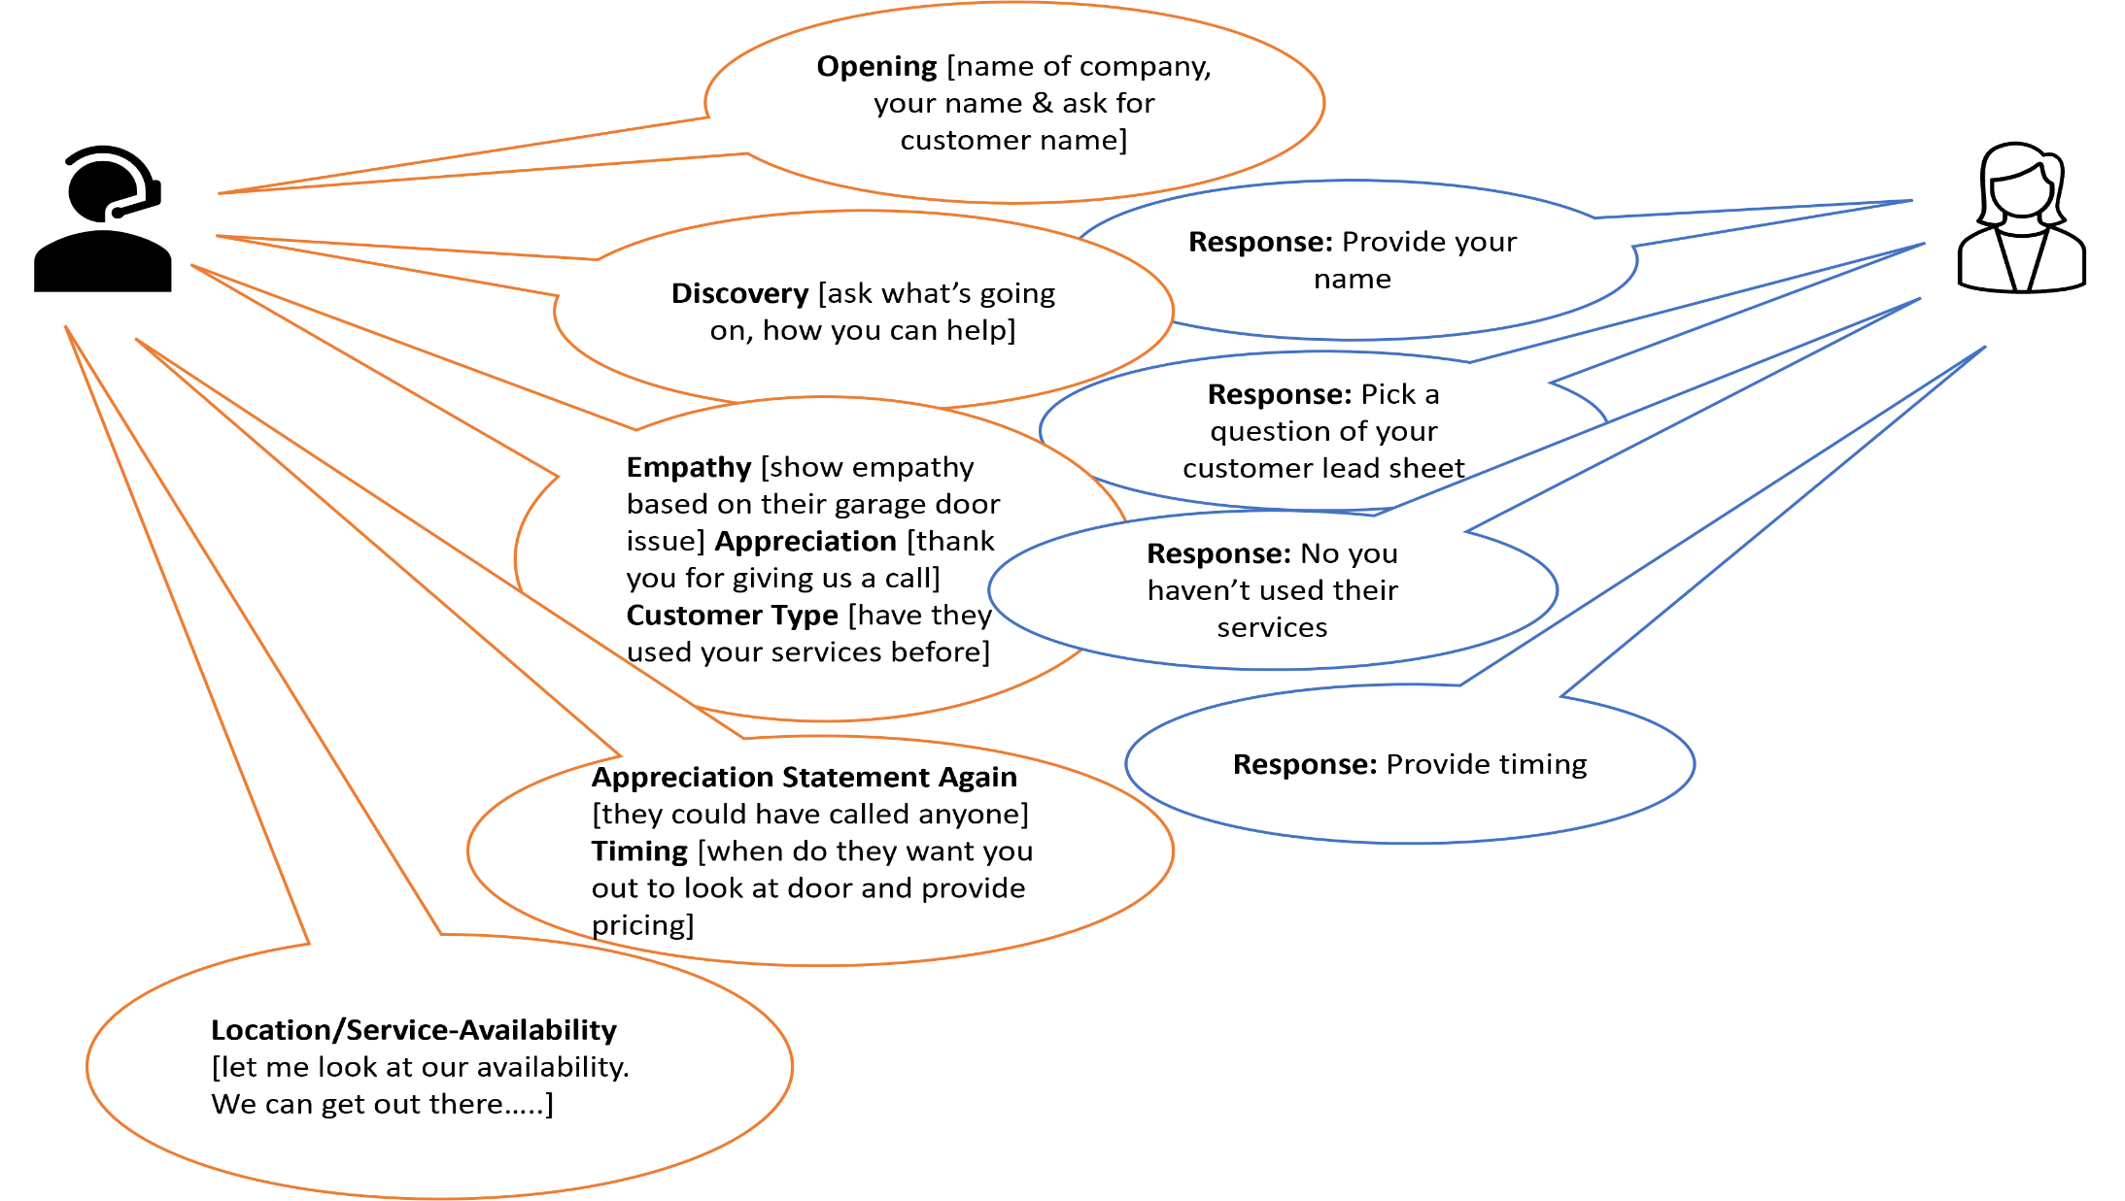
Solid Ways To Structure Your Approach-
Don’t Spill The Beans-Practice Makes Perfect
❶Partner Up
(1 Customer/1 Agent)-Crystal To Assign Partners
❷Pick 1 Customer Question
Page 11 Workbook [Lead Call]
❸Show Us What You Got!
Activity
Activity Time
15 Minutes
Notes:
In this group activity, we’re looking for 6 volunteers. 3 will be playing the role of agent and 3 will be playing the role of customer.
Crystal will be randomly picking if we don’t get 6 volunteers.
-Customer role will pull their questions off of page 11 from workbook (if another agent has already used a question, then pick another one)
-Agent role- can us the page we will keep up to help them stay on track or they can refer to page 13 of their workbook

Slide 21
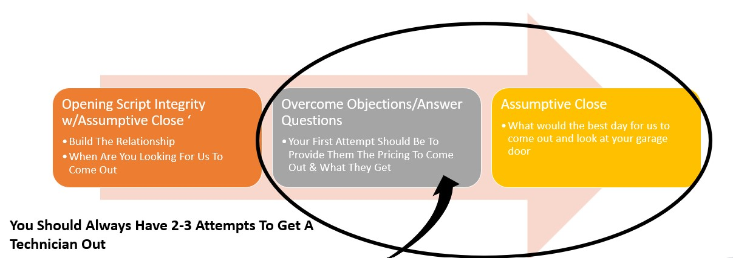
Solid Ways To Structure Your Approach-
Script Flow-Beginning Your Build
Page 15 In Workbook
Notes:
Important things to remember:
1.) Connect with your customer
2.) Maintain Call Control
3.) Use assumptive close questions (when are you looking for us to come out)
4.) Be prepared to have to overcome objections with appropriate rebuttals that also include an assumptive close
There is a lengthy PowerPoint presentation script flow that includes FAQ’s and Rebuttals posted to the GDF site

Slide 22
Solid Ways To Structure Your Approach-
Script Flow-Rebuttal Example
What Does A Rebuttal Sound Like
Page 15 In Workbook
Thank you for calling Garage Door Freedom. This is Angela, who do I have the pleasure of speaking with?
My name’s Crystal
Hi Crystal, how can I help you?
Angela, I have a broken spring and I’m calling around to get pricing!
Crystal, I completely understand you wanting to know pricing. We value our customers and want to make sure when we give a prices, it’s accurate. Our cost to come out and complete a full inspection is ONLY $45 and our technician will write up a work order for you. If you sign off on the work order, he’ll be ready to jump into the repair work. What is a good time for us to come out?
First off Crystal, I’m sorry to hear you have a broken spring, you’ve called the right place I can help you. Have you ever used our services before?
I haven’t. This is the first time I’ve had anything happen to my garage door.
Thank you, Crystal, for thinking of us for your garage door needs. When are you looking for one of our technicians to go out and look and provide you pricing?
I’m not wanting anyone out until I understand what the cost is going to be!
Notes:
Crystal and I are going to do a quick role play. Keep in mind any pricing given or questions asks are very general.
Crystal will be the customer and I’ll be the agent

Slide 23
Solid Ways To Structure Your Approach-
Script Flow-Rebuttals
Steps To Follow
Page 15 In Workbook
Identify Common Questions
Separate Out Type Of Customer
Create Your Responses w/Assumptive Close
Create Your Basic Script Flow
Maintaining Call Control Is Key To Overcoming Objections & Answering Customers Questions
Notes:
We encourage all GDF members to share any rebuttals they may use to overcome objections. After this session, Crystal will start a group email and we encourage you to share your Rebuttals. Sharing is caring!!!

Slide 24

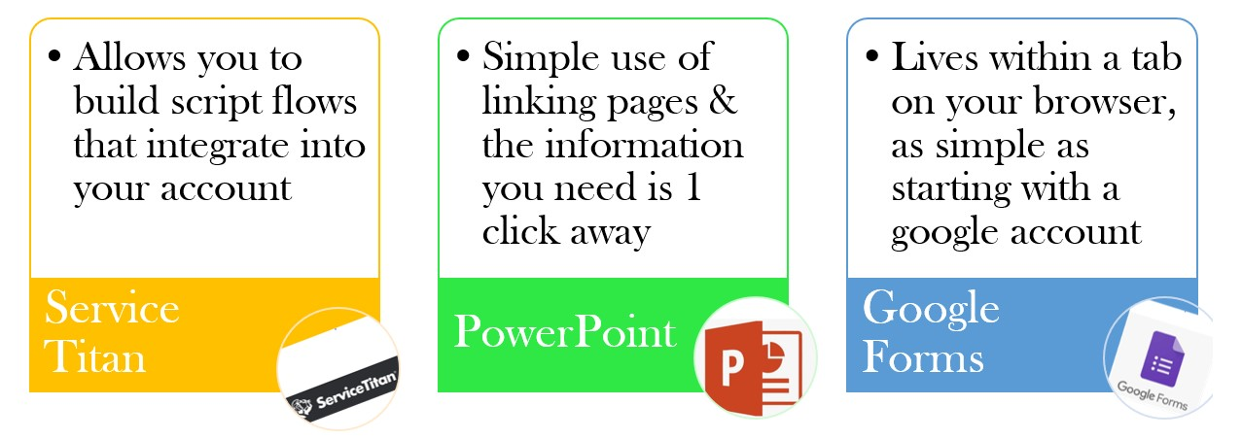
Solid Ways To Structure Your Approach-Building Your Script-Platform To Build Out Scripting
Using Technology To Store Your Interactive Script

Slide 25

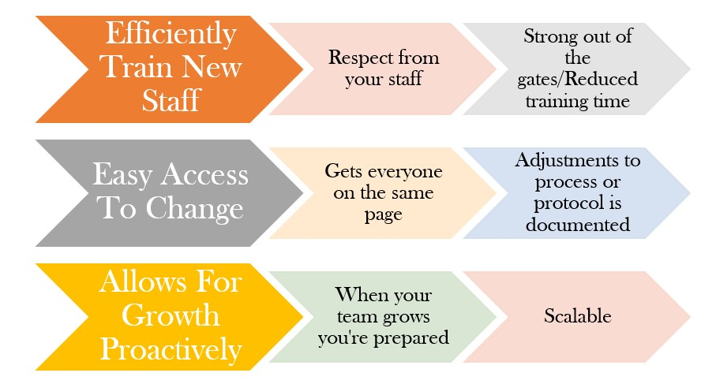
Solid Ways To Structure Your Approach-
Benefits Of Building A Script
Top 3 Benefits Of Having A Script AND FAQ’s/Rebuttals
How Can You See This Benefiting You?

Slide 26
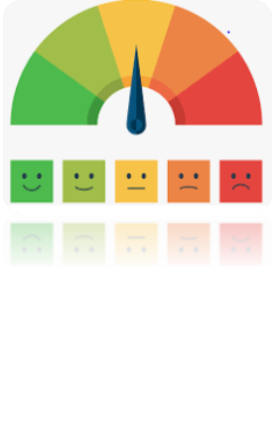

KPI’s-Knowing Where You Are & Where You Want To Be
Page 26-28 In Workbook
GDF Members-Questions To Ask Yourself
Do You Know What KPI Means?
Are You Tracking Your Book%?
Do You Know Who’s Responsible For Managing KPI’s?
Do You Have A Platform That You Are Using To Easily Pull Your Numbers From?
Are You Auditing The Calls Coming In To Make Sure Agents/Staff Are Correctly Dispositioning Their Calls?
What Call Types Do You Consider Non- Lead Vs. Lead ?
Employees Answering Main Line Phone Calls Should Be Compensated For Hitting Goal!
Frontline Employees That Are Handling The Phones Should Be Focused On Making Every Call/Lead Count!
KPI’s Are Just As Important To Measure In The Phone Channel As Technicians/Installers Out In The Field!
Know Your Lost Potential Revenue For Every Missed Call!
Everyone Is Responsible For KPI’s!

Slide 27
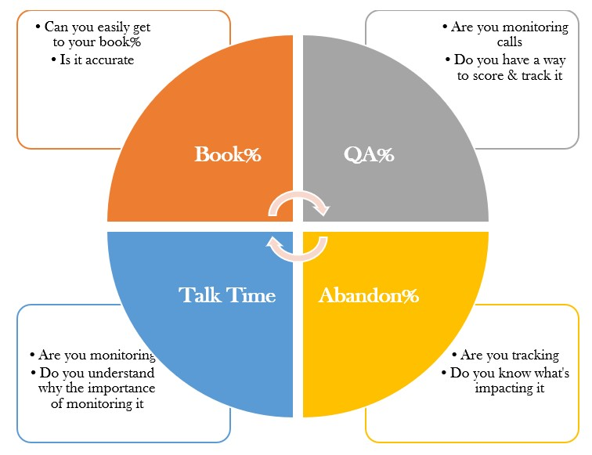
KPI’s-Knowing Where You Are & Where You Want To Be
Top 4 KPI’s For Call Center

Slide 28
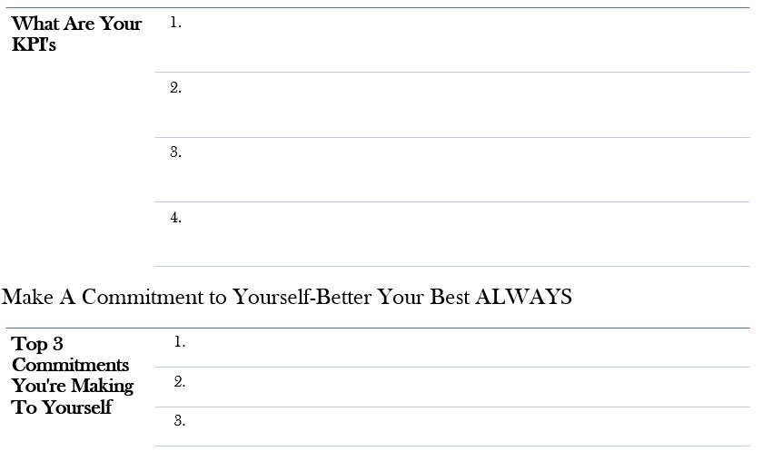
KPI’s-Knowing Where You Are & Where You Want To Be
Understanding Where You Are & Where You Want To Be
Page 28 In Workbook

Slide 29
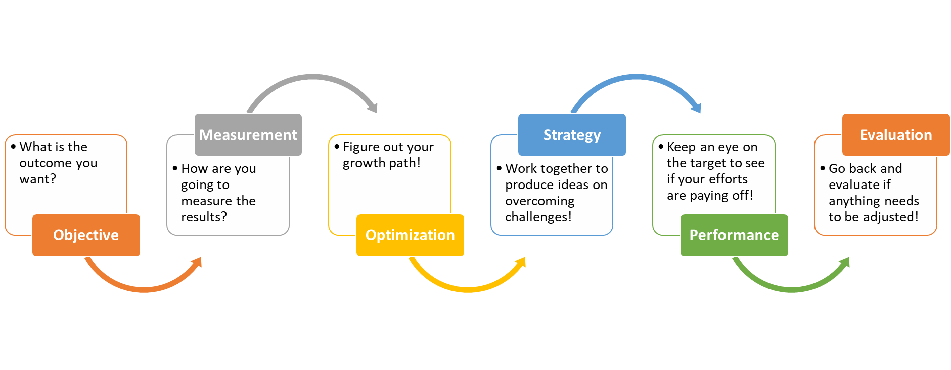
KPI’s-Knowing Where You Are & Where You Want To Be
Managing Your KPI’s Is A Daily Activity!

Slide 30

KPI’s-Book Rate Statistics
Oh, you handle more than 10 calls a day. Here’s a quick grid of your revenue gain not by adding calls or headcount but having someone answering the phones that’s in it to win it!
If you receive 10 calls a day and the employee answering the phones had a book% of 85% vs. 55%, the revenue variance would be $906 revenue gain DAILY!
Seems small, but if you look at it over 12 months, that’s a $329,801 revenue growth.
Data based on 40% Customer Service Calls, 12% Cancel Rate, 85% Tech CR and Ave. Ticket @ $650

Slide 31
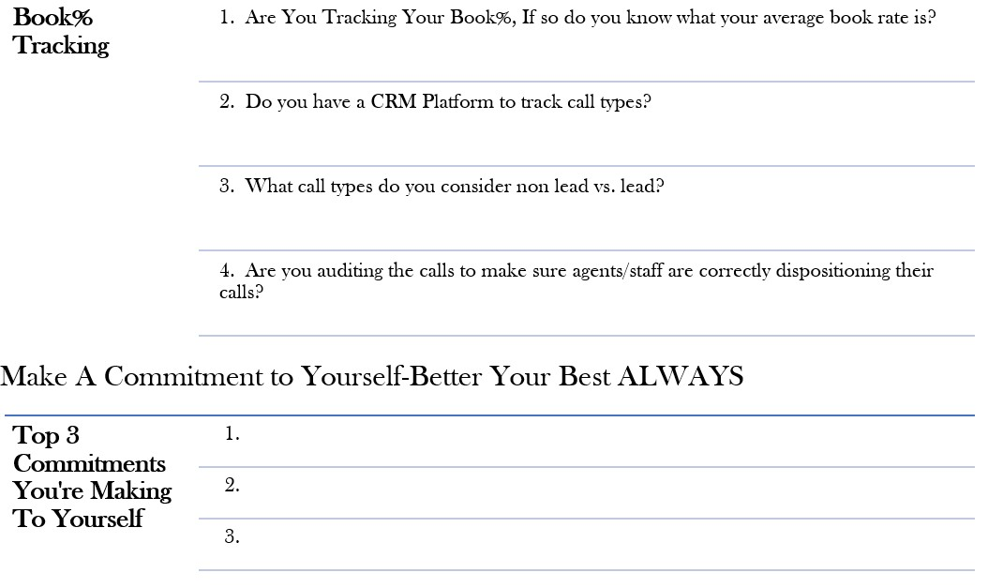
KPI’s-Book Rate-Book Rate Tracking
Turn To Page 29 In Your Workbook
Take A Few Minutes To Answer The Questions
Make 3 Commitments To Yourself

Slide 32
KPI’s-Quality Monitoring-QA%
Inspect What You Expect
How Does Your Team Sound On The Phone?
Are They Branding The Company?
Are They Overcoming Objections With Appropriate Rebuttals?
Are They Following The Script Flow?
Are They Providing and Gathering Accurate Information?
Are They Using An Assumptive Close After Answering Customers Questions [ABC-Always Be Closing]?

Slide 33
KPI’s-Quality Assurance
Page31In Workbook
GDF Members-Questions To Ask Yourself
Do You Spot Check/Audit Calls Your Team Members Are Handling?
Do You Listen To Your Own Calls And Do Self Assessments?
Are You Grading The Calls So You Can Identify Your Baseline?
Are You Leveraging Call Recordings For Training & Quality Purposes?
Do You Have A Scorecard Compendium That Outlines And Defines All Grading Compenants?

Slide 34
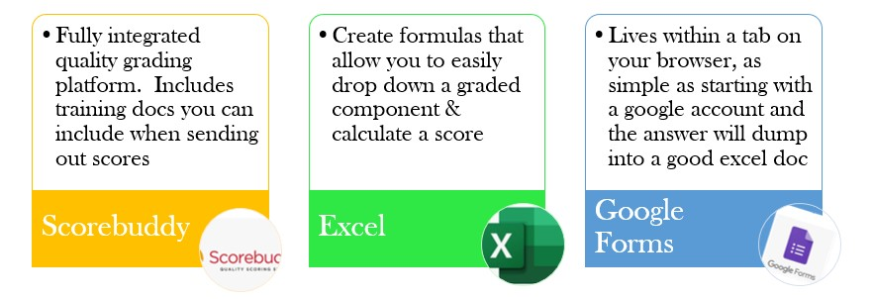
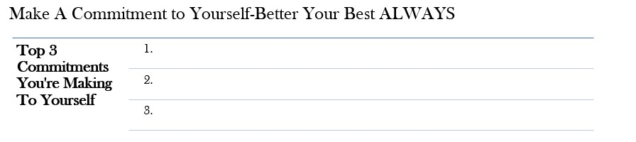
KPI’s-Knowing Where You Are & Where You Want To Be
Understanding Where You Are & Where You Want To Be
Page 31 In Workbook

Slide 35
KPI’s-Abandon%-Lost Potential Revenue
Do you track your lost potential revenue associated with missed calls?
Do you track your missed calls?
Do you have a plan in place for returning missed calls?
Page 32 In Workbook

Slide 36
KPI’s-Abandon%-Lost Potential Revenue
Lost Potential Revenue Numbers
Data based on 40% Customer Service Calls, 12% cancel rate, 85% tech CR and Ave. Ticket @ $650

Slide 37
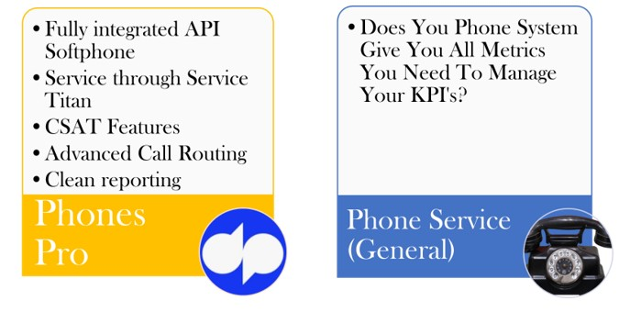
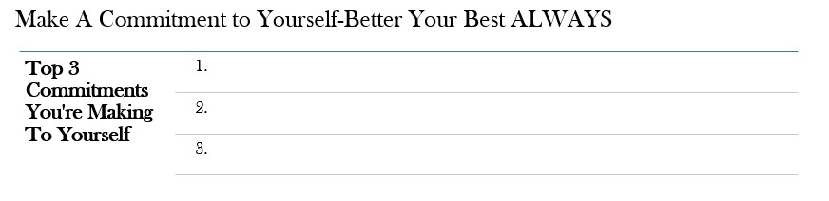
KPI’s-Abandon%-Leveraging Technology
Page 33 In Workbook

Slide 38
KPI’s-Talk Time, It’s Important
Do you know the call types that make the calls shorter?
Are you monitoring your talk time to become more efficient?
Do you know the call types that make the calls longer?
Page 34 In Workbook

Slide 39
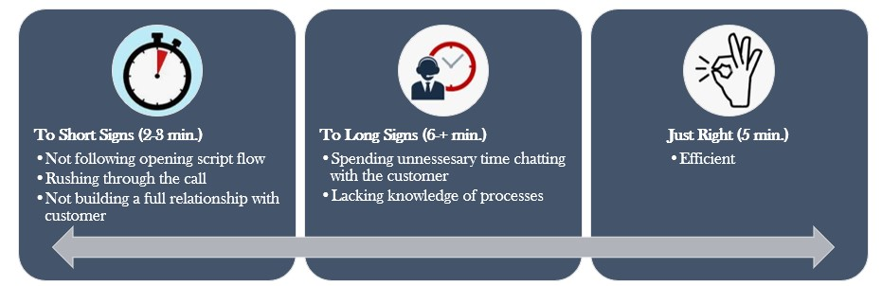
KPI’s-Talk Time, It’s Important
Page 34 In Workbook

Slide 40

KPI’s-Talk Time, It’s Important
Are you giving or getting formal refresher training?
Are you giving or getting information on a regular basis of KPI’s?
Are you giving or getting real time coaching?
Page 36 In Workbook

Slide 41
Coaching-Homework Assignment
Having A Strong Player Is A Reflection Of Their Coach
Homework Assignment
Page 35 In Workbook
Provide Your Team ‘Player’ With A Checkpoint Assessment

Slide 42
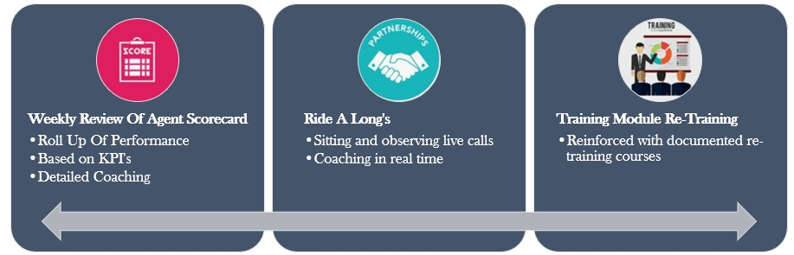
Coaching-Top 3 Tools
Page 36 In Workbook

Slide 43

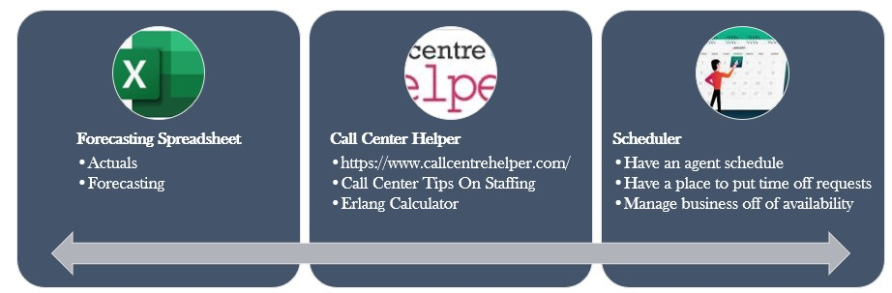
Leveraging Technology
Do you know if you’re going to be expecting more calls on a certain day or do you play the ‘Monday’s All Hands-On Deck’ strategy?

Slide 44


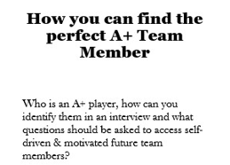
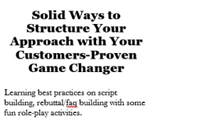
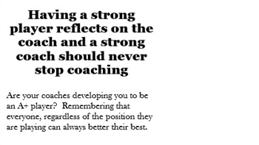

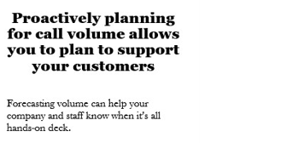
We Appreciate You Taking Time Out Of Your Busy Day
Who Would Like To Share At Least 1 Take Away From Today’s Session
Notes:
Our focus today is on how you can better your best with all things Call Center! Whether you have a small shop with only 1 person answering the phones or you have a handful of people answering the phones, we can all agree that your ultimate goal is to grow your business. What does that mean….Not only will you need more technicians out in the field supporting your customers but also you’ll need more associates answering the phones.
Things We’ll Be Reviewing Today:
How you find A+ Team Members
Tips to ease the pain of onboarding
How to build out scripting, FAQ’s and Rebuttals
Learning about how to build out Call Center KPI’s
Measuring and Coaching to improve performance
And last but not least, how to proactively plan for call volume
So often we start our work day off with looking at all the stuff we need to get done in a day to WORK ON THE BUSINESS and then the emails and phone calls start coming in. We jump into ‘FIREFIGHTING MODE’ and by the end of the day we never worked on how to work on ‘FIRE PREVENTION’. I want to THANK YOU for giving up some time out of your busy day so you can work ON THE BUSINESS.

