Slide 1
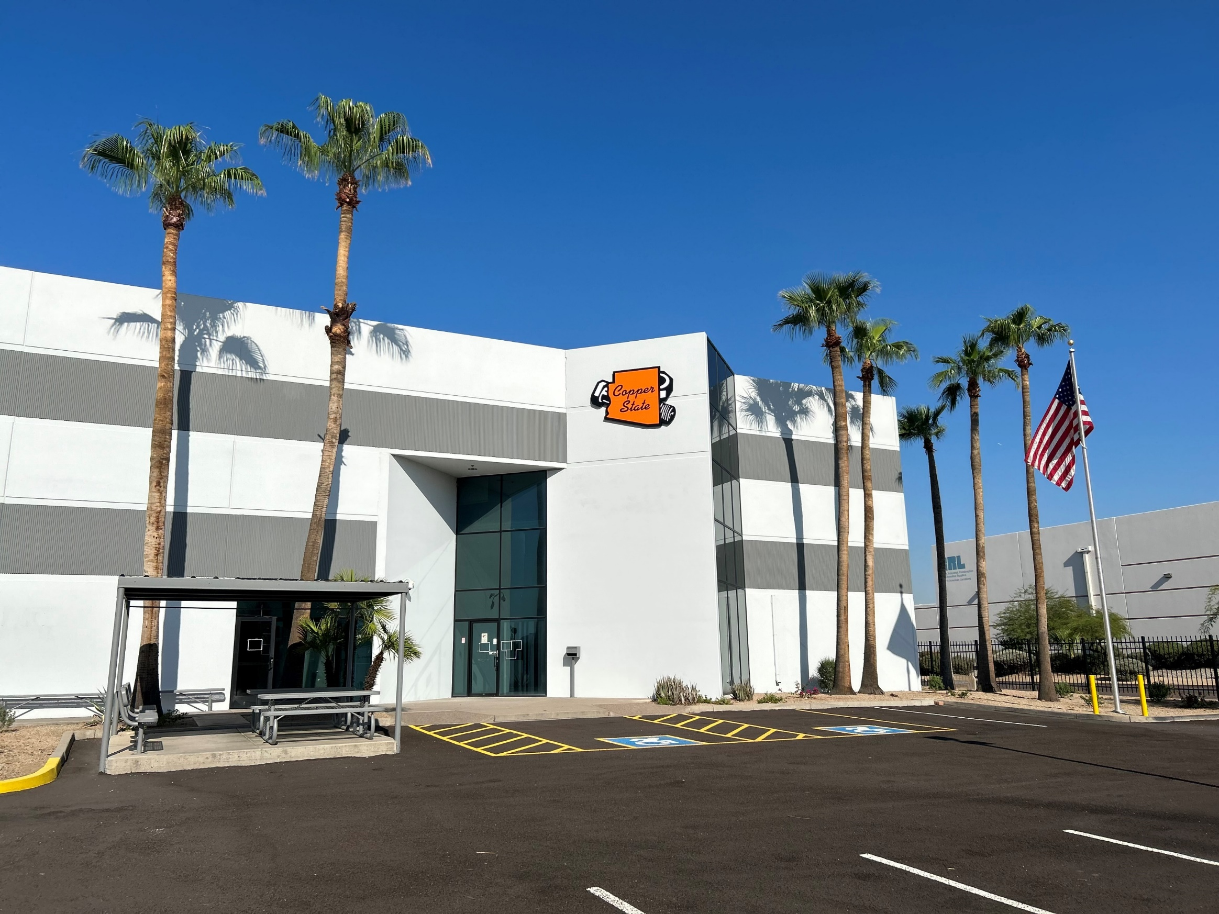
Fasteners Construction Products Industrial Supplies Safety & PPE Cutting Tools & Abrasives Tools & Accessories Specialty Items
Introduction to our commitment of support
Copper State Bolt & Nut
Notes:
Slide 1: Intro
Overview of products and services we have provided customers over the years.

Slide 2
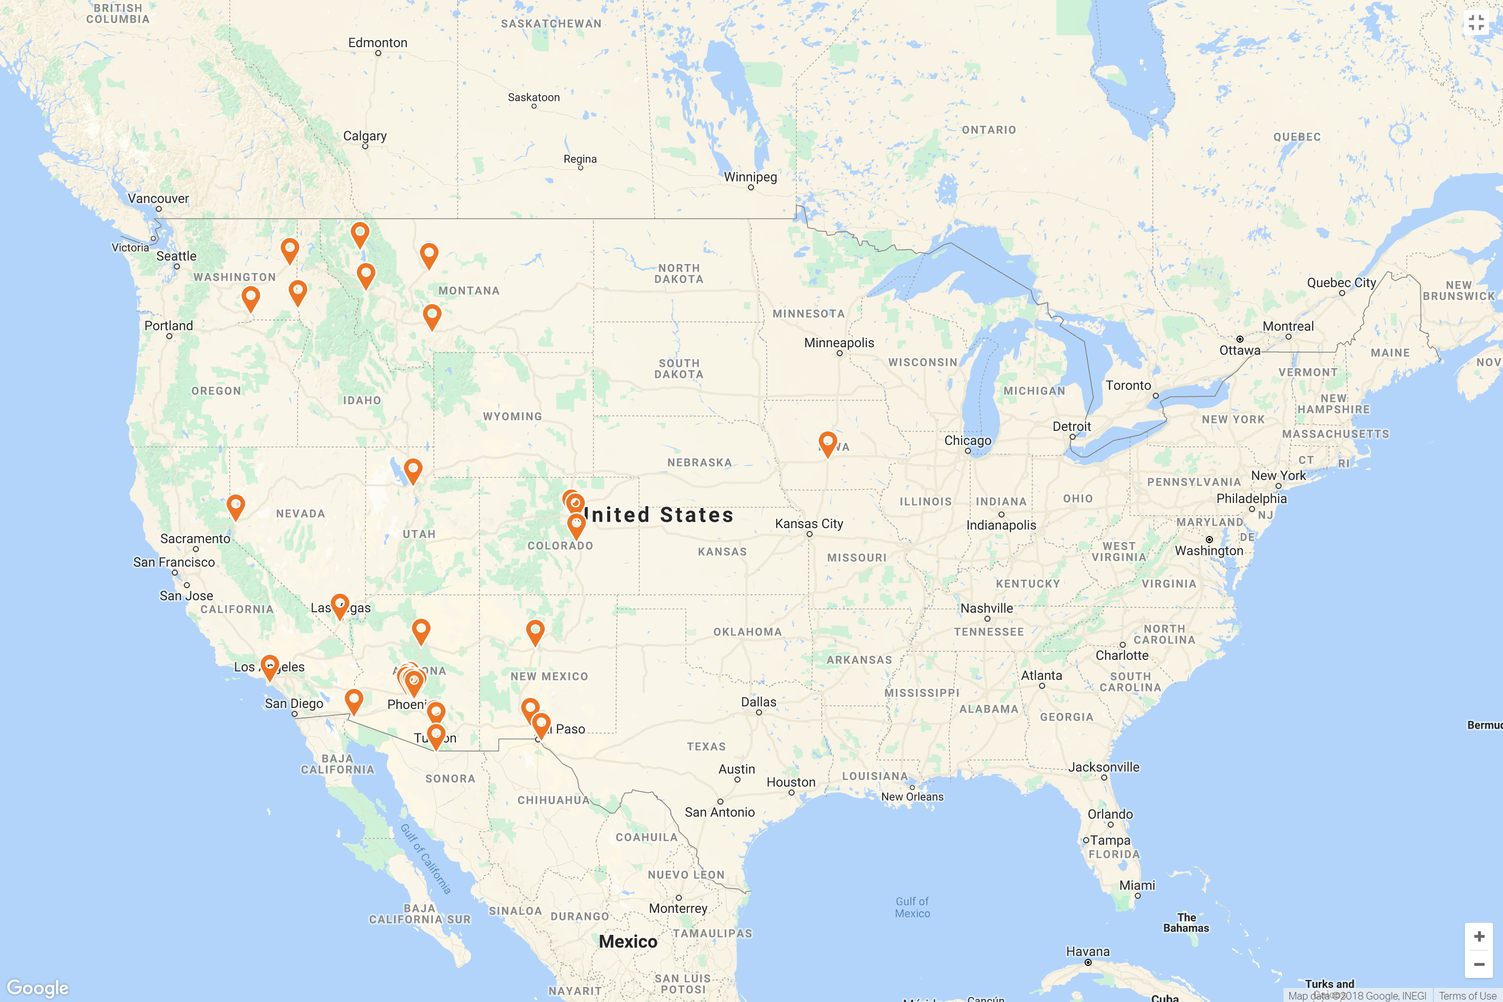
Copper State At A Glance:
1700+ Key Customers
(16,000 Overall)
600+ Supplier Partners
(1,100 Overall)
30+ Locations
in 11 States
Shipping to 20+ Countries
On 6 Continents
Notes:
Slide 2: Copper State at a glance; Giving an idea of how big CSBN is and the clout we have.

Slide 3
Copper State & Garage Door Companies- ‘24 Stats:
25+ States
supported by Copper State
Over
13,000+
pairs of Gloves
Working with 250+
Garage Door Companies
4.5M+
Pieces of zinc hardware
1,200+ pairs of
safety glasses
350+ technician kits put together by Copper State
Notes:
Slide 3:

Slide 4
New Hire Technician Kits Include:
Milwaukee Rolling Packout
+ Low Profile Organizer
Milwaukee Packout Backpack
4x Milwaukee Power Tools
2x M18 Batteries
AND 30+ Additional Tools & Accessories

Slide 5
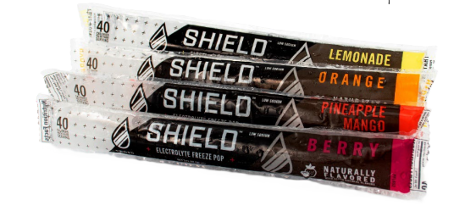
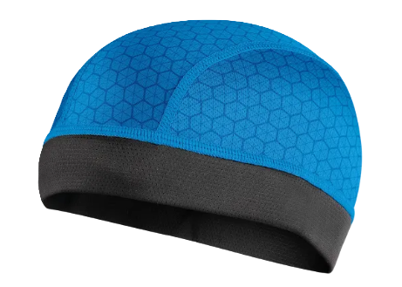
Popular Cooling Products:
3 fl oz Freeze Pops
Cooling Towels &
Cooling Skull Caps
16.9 fl oz Drink Mix

Slide 6
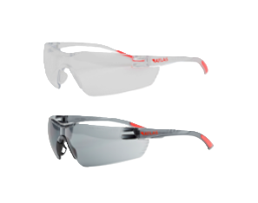
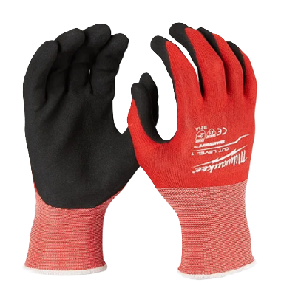
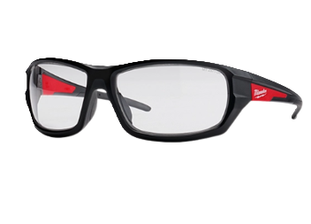
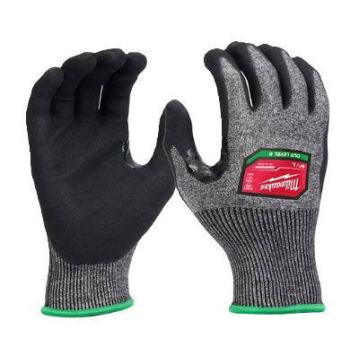
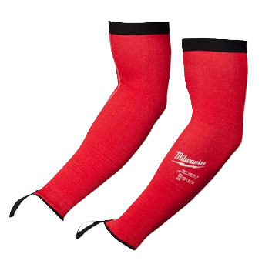
Safety Glasses & Gloves:
Economy Safety Glasses
(Clear or Tinted)
Other Safety Accessories
-or- Upgrade to Milwaukee
Safety Glasses
Cut Lvl 6 High-Dex Gloves
Cut Lvl 1 Gloves
Cut Lvl 3 Protective Sleeves

Slide 7
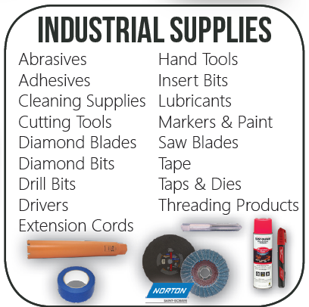
Other Product Lines:
Notes:
Slide 10: “you already know we supply bolts & nuts, here are some other things we can provide to reduce your work needed when looking for materials.”

Slide 8
Your Copper State Bolt & Nut Contacts
Luis Martinez- Branch Manager, 602-437-8677
lmartinez@copperstate.com
Mark Wulff- Regional VP of Construction, 602-399-0905
mwulff@copperstate.com
Cody Creelman- Account Manager, 602-290-2808
- ccreelman@copperstate.com
Notes:
Contacts page

Slide 9
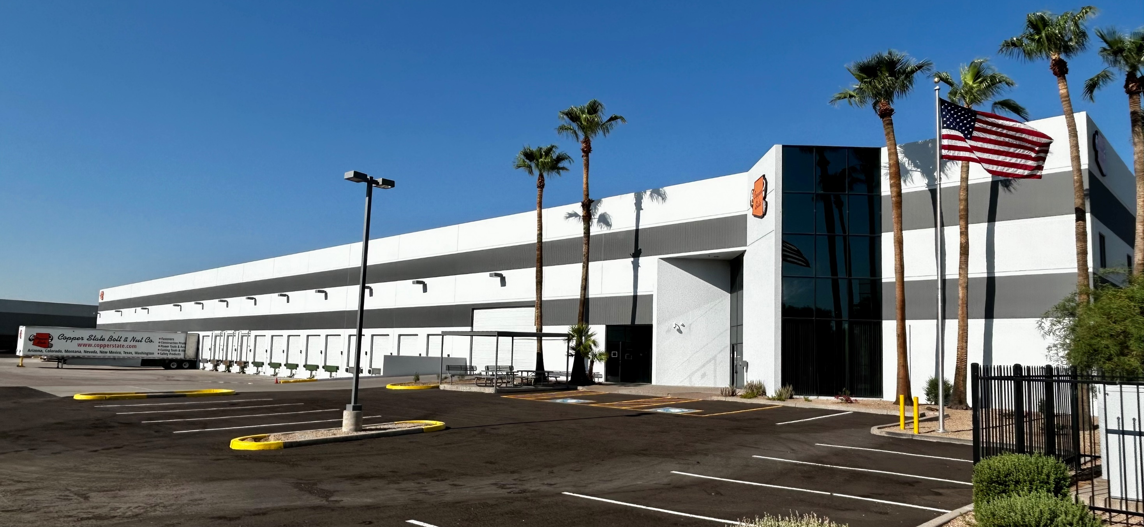
Thank you!
We look forward to earning your business and working to support your project needs.
Thank you for the opportunity to develop our partnership together!
Notes:
Slide 11: End. Thank you.

